Slide 1
SD: Methodology
26-Apr-18 | Start
27-Apr-18 | 39
29-Apr-18 | 41
30-Apr-18 | 60
07 May 18 | 93
08 May 18 | 116
22 May 18 | 3: 117-128
23 May 18 | 3: 129-132
21 Jun 18 | 3: 133-139
29 Jun 18 | 3: 140-145
Appendix
Online

Slide 2
Agile with TFS
Ch | Date
1 | 29 Apr 18
2 | 01 May 18
3
4
5
6
7
8
Agile Project Management 2016 using Team Foundation Server

Slide 3
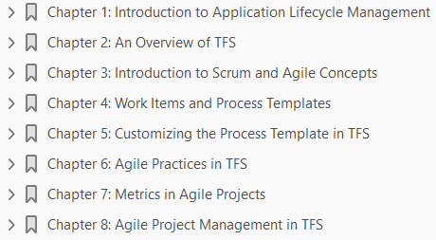

Slide 4
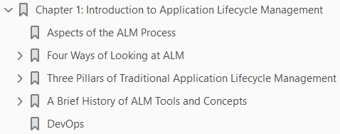
1
Introduction to Application Lifecycle Management

Slide 5
Intro
What do you think about when you hear the term Application Lifecycle Management (ALM) ?
During a seminar tour in 2005 in Sweden, presenting on Microsoft Visual Studio Team System, we asked people what ALM was and whether they cared about it.
To our surprise, many people equated ALM with operations and maintenance.
This is still often the case when we visit companies, although more people today are aware of the term.
Was that your answer as well?
Does ALM include more than just operations? Yes, it does.
ALM is the thread that ties the development lifecycle together.
It involves all the steps necessary to coordinate development lifecycle activities.
Operations are just one part of the ALM process.
Other elements range from requirements gathering to more technical things like the build and deploy processes.

Slide 6
Aspects of the ALM Process
All software development includes various steps performed by people playing specific roles.
There are many different roles, or disciplines, in the ALM process, and we define some of them in this section. (The process could include more roles, but we focus on the primary ones.)
Look at Figure 1-1 , which illustrates ALM and some of its aspects.
You can see the flow from the birth of an application, when the business need first arises, to when the business need no longer exists and the application dies.
Once the thought of a new application (or system) is born, many organizations do some portfolio rationalization.
This means you discuss whether an existing system can handle the need or whether a new system has to be developed.
If a new system must be built, you enter the software development lifecycle (SDLC) and develop the system, test it, and deploy the system into operation.
This is the point at which you do a handover so that operations can maintain and refine the system.
Once in production, the system (hopefully) delivers the intended business value until retirement.

Slide 7
Aspects of the ALM Process |
While in operation, the system usually is updated or undergoes bug fixes; at such times, change requests (CRs) are written.
For each CR, you go through the same process again.
It’s essential to understand that all business software development is a team effort.
The roles require collaboration in order to deliver business value to the organization.
If you don’t have this collaboration, the value of the system most likely will be considerably lower than it could be.
One step up from the project level, it’s also important to have collaboration between all roles involved in the ALM process, so that you perform this process in the most optimal way.
The roles in the ALM process is shown in Section 1.
All project efforts are done collaboratively. No role can act separately from the others if you’re to succeed with any project.
It’s essential for everybody involved to have a collaborative mindset and to have the business value as their primary focus at every phase of the project.

Slide 8
Aspects of the ALM Process ||
If you’re part of an agile development process, such as a Scrum project, you might have only three roles:
product owner
Scrum master,
team members
This doesn’t mean the roles just described don’t apply, though
They’re all essential in most projects; it’s just that in an agile project, you may not be labeled
a developer
an architect
Rather, you’re a team member, and you and your co-members share responsibility for the work you’re doing.
We go deeper into the agile world later in the book (see Chapter 4).

Slide 9
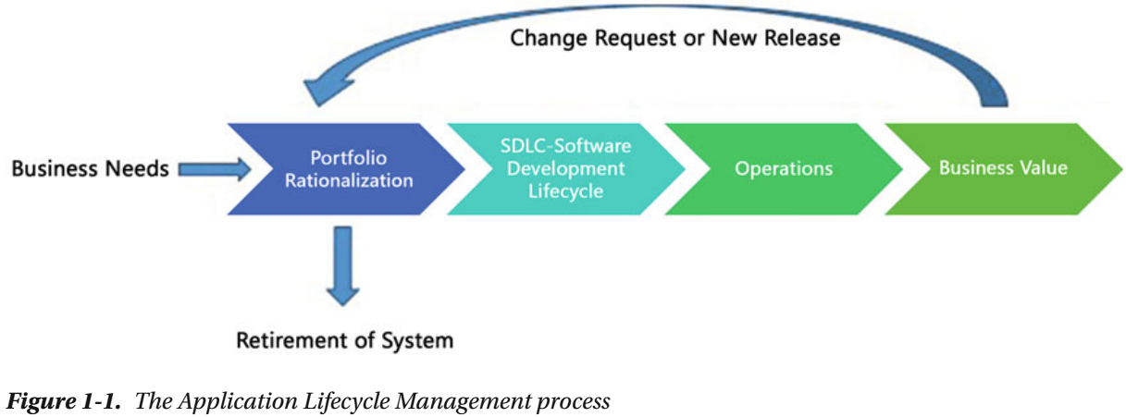
Figure 1-1

Slide 10
Section 1
The roles in the ALM process include, but aren’t limited to, the following:
Stakeholders: Stakeholders are usually the people who either pay for the project or have decision-making rights about what to build.
We like to also include end users in this group so not only management has a stake in a project.
Business manager: Somebody has to decide that a development activity is going to start. After initial analysis of the business needs, a business manager decides to initiate a project to develop an application or system that will deliver the expected business value.
A business manager, for instance, must be involved in the approval process for a new suggested project, including portfolio rationalization, before the company makes a decision to go ahead.
IT managers are also part of this process, of course, because IT staff will probably be involved in the project’s development and deployment into the infrastructure.
Project manager, product owner, or Scrum master: Suitable individuals are selected to fill these roles, and they set to work on the project after the company decides to go ahead with the project.
Ideally, these people continue leading the project all the way through, so that you have continuity in project management.

Slide 11
Section 1 |
Project Management Office (PMO) decision makers: These individuals are also involved in planning, because a new project may change or expand the company’s portfolio.
Business analyst: After requirements collection starts, the business analyst has much to do.
Usually, initial requirements are gathered when the business need arises, but the real work often begins after portfolio rationalization.
A business analyst is responsible for analyzing the business needs and requirements of the stakeholders, to help identify business problems and propose solutions.
Within the system’s development lifecycle, the business analyst typically performs a collaborative function between the business side of an enterprise and the providers of services to the enterprise.
Architect: The architect draws an initial picture of the solution.
We don’t go into detail here, because Chapter 4 does that. But briefly, the architect draws the blueprint of the system, and the system designers or engineers use this blueprint.
The blueprint includes the level of freedom necessary in the system: scalability, hardware replacement, new user interfaces, and so on. The architect must consider all these issues.

Slide 12
Section 1 ||
User experience (UX) design team: UX design should be a core deliverable and not something you leave to the developers to handle.
Unfortunately, it’s often overlooked; it should be given more consideration. It’s important to have close collaboration between the UX team (which could be just one person) and the development team.
The best solution is obviously to have a UX expert on the development team throughout the project, but sometimes that isn’t possible.
The UX design is important in making sure users can perceive the value of the system.
You can write the best business logic in the world, but if the UX is badly designed, users probably won’t think the system is any good.
Database administrators (DBAs): Almost every business system or application uses a database in some way.
DBAs can make your databases run like lightning with good up-time, so it’s essential to use their expertise in any project involving a database.
Be nice to them; they can give you lots of tips about how to make a smarter system.
Alas for DBAs, developers handle this work more and more frequently. This means developers are expected to have vertical knowledge and not just focus on coding.

Slide 13
Section 1 |||
Developers: “Developers, developers, developers!” as Microsoft CEO Steve Ballmer shouted in a famous video.
And who can blame him? These are the people working their magic to realize the system by using the architecture blueprint drawn from the requirements.
Moreover, developers modify or extend the code when change requests come in.
Testers: I’d rather not see testing as a separate activity.
Don’t get me wrong, it’s a role, but testing is something you should consider from the first time you write down a requirement and continue doing during the whole process.
Testers and test managers help you secure quality, but modern development practices include testing by developers as well.
For instance, in Test Driven Development (TDD), developers write tests that can be automated and run at build time or as part of checking in to version control.
Operations and maintenance staff: When an application or system is finished, it’s handed over to operations.
The operations staff takes care of it until it retires, often with the help of the original developers, who come in to do bug fixes and new upgrades.

Slide 14
Section 1 ||||
Don’t forget to involve these people early in the process, at the point when the initial architecture is considered, and keep them involved with the project until everything is done.
They can provide great input about what can and can’t be done within the company infrastructure. So, operations is just one part—although an important one—of ALM.

Slide 15
Four Ways of Looking at ALM
ALM is the glue that ties together the roles we just discussed and the activities they perform.
Let’s consider four ways of looking at ALM (see Figure 1-2 ).
We’ve chosen these four because we’ve seen this separation in many of the organizations we’ve worked with or spoken to:
Software development lifecycle (SDLC) view: This is perhaps the most common way of looking at ALM, because development has “owned” management of the application lifecycle for a long time.
This could be an effect of the gap between the business side and the IT side in most organizations, and IT has taken the lead.
Service management or operations view: Operations have also been (in our experience) unfortunately separated from IT development.
This has resulted in operations having its own view of ALM and the problems in this area.
Application Portfolio Management (APM) view: Again, perhaps because of the gap between business and IT, we’ve seen many organizations with a portfolio ALM strategy in which IT development is only one small part.

Slide 16
Four Ways of Looking at ALM |
From a business view, the focus has been on how to handle the portfolio and not on the entire ALM process.
Unified view: Fortunately , some organizations focus on the entire ALM process by including all three of the preceding views.
This is the only way to take control over, and optimize, ALM.
For a CIO, it’s essential to have this view all the time; otherwise, things can easily get out of hand.
Let’s look at these four views in more detail, starting with the SDLC view.

Slide 17
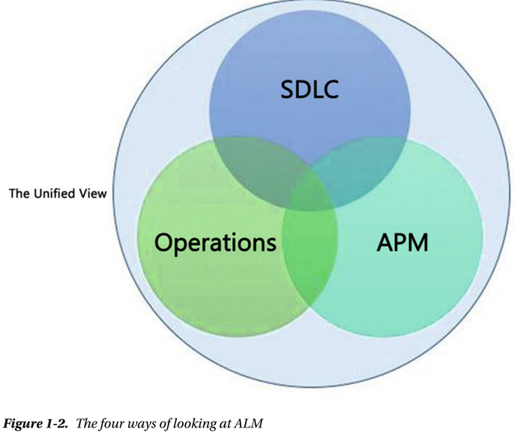
Figure 1-2

Slide 18
The SDLC View
Let’s consider ALM from an SDLC perspective first.
In Figure 1-3 , you can see the different phases of a typical development project and the roles most frequently involved.
Keep in mind that this is a simplified view for the sake of this discussion.
We’ve also tried to fit in the different roles from the ALM process, presented earlier.
First, somebody comes up with an idea based analyzing the business needs: “Hey, wouldn’t it be great if we had a system that could help us do this (whatever the idea is)?”
It can also be the other way around; the idea comes first, and the business value is evaluated based on the idea.
An analysis or feasibility study is performed, costs are estimated, and (hopefully) a decision is made by IT and business management to start an IT project.
A project manager (PM) is selected to be responsible for the project; the PM begins gathering requirements with the help of business analysts, PMO decision makers, users, or others affected.
The PM also starts planning the project in as much detail as possible at this moment.

Slide 19
The SDLC View |
When that is done, the architect begins looking at how to realize the new system, and the initial design is chosen.
The initial design is evaluated and updated based on what happens during the project and how requirements change throughout the project.
Development beings, including work performed by developers, user interface (UI) designers, and DBAs (and anyone else not mentioned here but important for the project).
Testing is, at least for us, something done all along the way—from requirements specification to delivered code—so it doesn’t get a separate box in Figure 1-3.
We include acceptance testing by end users or stakeholders in the Development box.
After the system has gone through acceptance testing, it’s delivered to operations for use in the organization.
Of course, the process doesn’t end here.
This cycle is generally repeated over and over as new versions are rolled out and bug fixes are implemented.

Slide 20
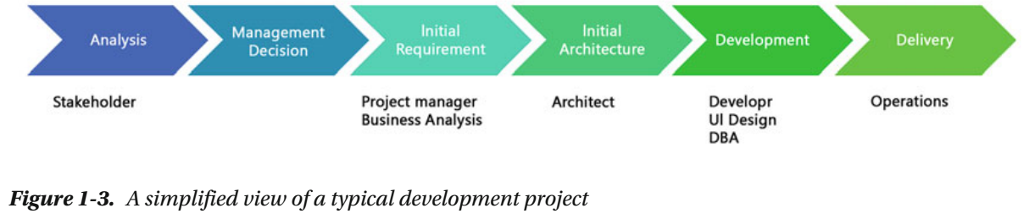
Figure 1-3

Slide 21
ALM
What ALM does in this development process is support the coordination of all development lifecycle activities by doing the following:
Making sure you have processes that span these activities.
Managing the relationships between development project artifacts used or produced by these activities (in other words, providing traceability).
These artifacts include UI mockups done at requirements gathering, source code, executable code, build scripts, test plans, and so on.
Reporting on the progress of the development effort as a whole so you have transparency for everyone regarding project advancement.
As you can see, ALM doesn’t support a specific activity: its purpose is to keep all activities in sync.
It does this so you can focus on delivering systems that meet the needs and requirements of the business.
By having an ALM process that helps you synchronize your development activities, you can more easily determine if any activity is underperforming and thus take corrective actions.

Slide 22
The Service Management or Operations View
From a service management or operations view , you can look at ALM as in this quote from ITIL Application Management by the Office of Government Commerce in the United Kingdom (TSO, 2002):
ALM “focuses on the activities that are involved with the deployment, operation, support, and optimization of the application.
The main objective is to ensure that the application, once built and deployed, can meet the service level that has been defined for it.”
When you see ALM from this perspective, it focuses on the life of an application or system in a production environment.
If, in the SDLC view, the development lifecycle starts with the decision to go ahead with a project, here it starts with deployment into the production environment.
Once deployed, the application is operated by the operations crew.
They handle bug fixes and change requests, and they also pat the application on its back (so to speak) to make it feel good and run smoothly.
This is a healthy way of looking at ALM in our opinion: Development and operations are two pieces of ALM, cooperating to manage the entire ALM process.

Slide 23
The Service Management or Operations View |
You should consider both pieces from the beginning when planning a development project; you can’t have one without the other.

Slide 24
The Application Portfolio Management View
In the APM view of ALM, you see the application as a product managed as part of a portfolio of products.
APM is a subset of Project Portfolio Management (PPM). Figure 1-4 illustrates this process.
This view comes from the Project Management Institute (PMI). Managing resources and the projects they work on is very important for any organization.
In Figure 1-4 , you can see that the product lifecycle starts with a business plan—the product is an application or system that is one part of the business plan.
An idea for an application is turned into a project and carried out through the project phases until it’s turned over to operations as a finished product.
When business requirements change or a new release (an upgrade in Figure 1-4 ) is required for some other reason, the project lifecycle starts again, and a new release is handed over to operations.
After a while (maybe years), the system or application is discarded (this is called divestment , the opposite of investment).
This view doesn’t specifically speak about the operations part or the development part of the process but should instead be seen in the light of APM.

Slide 25
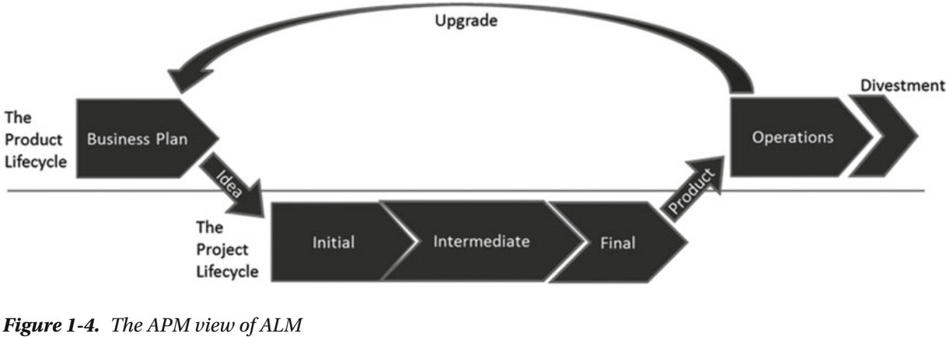
Figure 1-4

Slide 26
The Unified View
Finally, there is a unified view of ALM.
In this case , an effort is made to align the previous views with the business.
Here you do as the CIO would do:
you focus on the business needs, not on separate views
You do this to improve the capacity and agility of a project from beginning to end.
Figure 1-5 shows an overview of the unified ALM view of a business.
You probably recognize this figure from Figure 1-1.
We want to stress that with the unified view, you need to consider all aspects from the birth to the death of an application or a system, hence the circle around the figure.

Slide 27
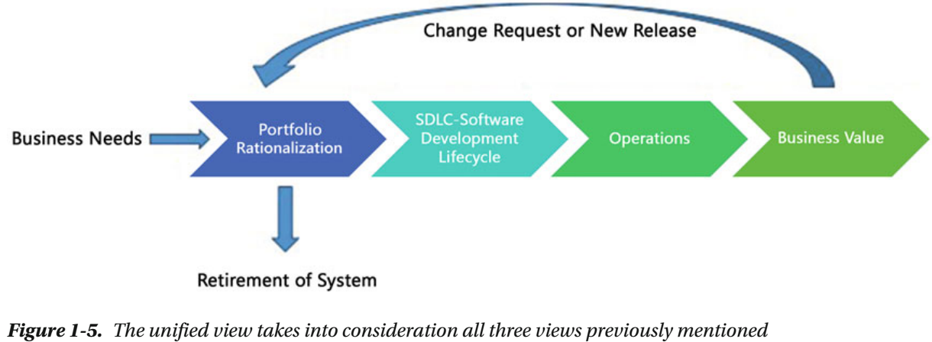
Figure 1-5

Slide 28
Three Pillars of Traditional ALM
Let’s now look at some important pillars of ALM that are independent of the view you take; see Figure 1-6.
These pillars were introduced by Forrester Research.
Traceability
Automation of High-Level Processes
Visibility
The following sections go over these pillars in greater detail, starting with traceability.

Slide 29
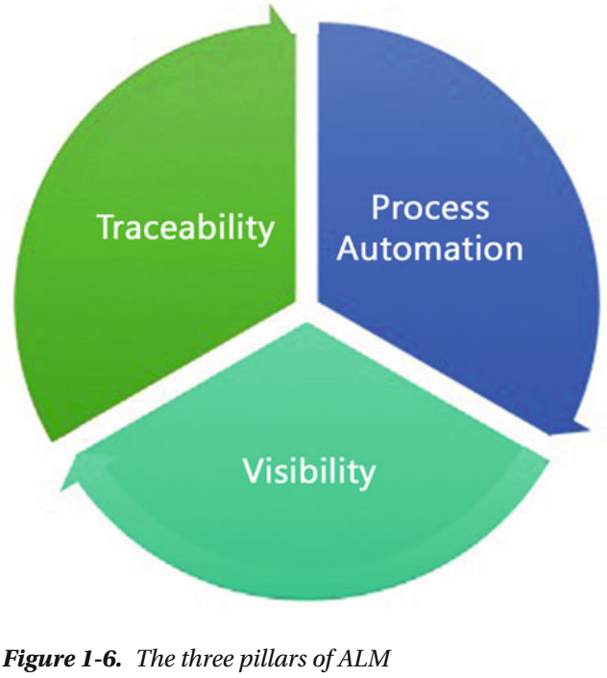
Figure 1-6

Slide 30
Traceability
Some customers we’ve seen have stopped performing upgrades on systems running in production because their companies had poor or no traceability in their systems.
For these customers, it was far too expensive to do upgrades because of the unexpected effects even a small change could have.
The companies had no way of knowing which original requirements were implemented where in the applications.
The effect was that a small change in one part of the code might affect another part, which would come as a surprise because poor traceability meant they had no way of seeing the code connection in advance.
One customers claimed (as we’ve heard in discussions with many other customers) that traceability can be a major cost driver in any enterprise if not done correctly.
There must be a way to trace requirements all the way to delivered code—through
architect models
design models
build scripts

Slide 31
Traceability |
unit tests
test cases, and so on
not only to make it easier to go back into the system when implementing bug fixes, but also to demonstrate that the system has delivered the things the business wanted.
You also need traceability in order to achieve internal as well as external compliance with rules and regulations.
If you develop applications for the medical industry, for example, you must comply with FDA regulations.
You also need traceability when change requests come in so you know where you updated the system and in which version you performed the update.

Slide 32
Automation of High-Level Processes
The next pillar of ALM automating high-level processes.
All organizations have processes in some way or the other.
In some organizations there are no written down, formal processes, but they still have processes.
For example, approval processes control handoffs between the analysis and design or build steps, or between deployment and testing.
Much of this is done manually in many projects, and ALM stresses the importance of automating these tasks for a more effective and less time-consuming process.
Having an automated process also decreases the error rate compared to handling the process manually.

Slide 33
Visibility
The third and last pillar of ALM is providing visibility into the progress of development efforts.
Many managers and stakeholders have limited visibility into the progress of development projects.
The visibility they have often comes from steering-group meetings, during which the project manager reviews the current situation.
Some would argue that this limitation is good, but if you want an effective process, you must ensure visibility.
Other interest groups, such as project members, also have limited visibility of the entire project despite being part of the project.
This is often due to the fact that reporting is difficult and can involve a lot of manual work.
Daily status reports take too much time and effort to produce, especially when you have information in many repositories.

Slide 34
A Brief History of ALM Tools and Concepts
You can resolve the three pillars of ALM manually if you want to, without using tools or automation. (ALM isn’t a new process description, even though Microsoft, IBM, HP, Atlassian, and the other big software houses are pushing ALM to drive sales of their respective ALM solutions.)
You can, for instance, continue to use Excel spreadsheets or, like one of our most dedicated agile colleagues, use sticky notes and a pad of paper to track requirements through use cases/scenarios, test cases, code, build, and so on, to delivered code.
It works, but this process takes a lot of time and requires much manual effort. With constant pressure to keep costs down, you need to make tracking requirements more effective.
Of course, project members can simplify the process by keeping reporting to the bare minimum.
With a good tool or set of tools, you can cut time (and thus costs) and effort, and still get the required traceability you want in your projects.
The same goes for reporting and other activities. Tools can, in our opinion, help you be more effective and also help you automate much of the ALM process into the tool(s).
Having the process built directly into your tools helps prevent the people involved from missing important steps by simplifying things.

Slide 35
A Brief History of ALM Tools and Concepts |
For instance, the agile friend we mentioned could definitely gain much from this, and he is looking into Microsoft Team Foundation Server (TFS) to see how that set of tools can help him and his teams be more productive.
Process automation and the use of tools to support and simplify daily jobs are great because they can keep you from making unnecessary mistakes.
Serena Software Inc. is one supplier of ALM tools, and the company has interesting insight into ALM and related concepts.

Slide 36
Serena Software - ALM Concepts
According to Serena Software, there are eight ALM concepts:
Modeling: Software modeling
Issue management: Keeping track of incoming issues during development and operations
Design: Designing the system or application
Construction: Developing the system or application
Production monitoring: The work of the operations staff
Build: Building the executable code
Test: Testing the software
Release management: Planning application releases
In order to synchronize these efforts, according to Serena Software , you need tools that span them and that help you automate and simplify the following activities.
If you look closely, you can see that these activities compare to ALM 2.0+, which we discuss shortly:

Slide 37
Serena Software - ALM Concepts |
Reporting
Traceability
Policies
Procedures
Processes
Collaboration
Imagine the Herculean task of keeping all those things in order manually. It’s impossible, if you want to get things right and keep an eye on the project’s status.
Projects today seem to be going better because the number of failed projects is decreasing.
Much of this progress is, according to Michael Azoff at the Butler Group, the result of
“major changes in software development: open source software projects; the Agile development movement; and advances in tooling, notably Application Lifecycle Management (ALM) tools.”

Slide 38
Serena Software - ALM Concepts ||
Some of these results have also been confirmed by later research, such as that by Scott W. Ambler at Ambysoft.
Now you understand why finding tools and development processes to help you with ALM is important.
There is increasing awareness of the ALM process among enterprises.
We see this among our customers. ALM is much more important now than it was only five years ago.

Slide 39
Application Lifecycle Management 1.0
Forrester Research has introduced some very useful concepts for ALM, including different versions of ALM and ALM tools.
This section looks at how Forrester defined ALM 1.0 and then continues to the latest version, ALM 2.0+.
As software has become more and more complex, role specialization has increased in IT organizations.
This has led to functional silos in different areas (roles), such as
Project management Business analysis
Architecture Development
Database administration Testing, and so on
As you may recall from the beginning of this chapter, you can see this in the ALM circle.
Having these silos in a company isn’t a problem, but having them without any positive interaction between them is an issue.
There is always a problem when you build impenetrable walls around you.
ALM vendors have driven this wall construction, because most of their tools historically have been developed for particular silos.

Slide 40
Application Lifecycle Management 1.0 |
For example, if you look at build-management tools, they have supported the build silo (naturally) but have little or no interaction with test and validation tools (which is strange because the first thing that usually happens in a test cycle is the build).
This occurs despite the fact that interaction between roles can generate obvious synergies with great potential.
You need to synchronize the ALM process to make the role-centric processes part of the overall process.
This might sound obvious, but it hasn’t happened until recently.
Instead of having complete integration between the roles or disciplines mentioned at the start of the chapter and the tools they use, there has been point-to-point integration—for example, a development tool is slightly integrated with a testing tool (or, probably the other way around).
Each tool uses its own data repository, so traceability and reporting are hard to handle in such an environment (see Figure 1-7 ).
This point-to-point integration makes the ALM process fragile and expensive.
However, this isn’t just a characteristic of ALM 1.0—it’s true for all integrations.

Slide 41
Application Lifecycle Management 1.0 ||
Imagine that one tool is updated or replaced: the integration may break, and new solutions have to be found to get it working again.
This scenario can be a reality if, for example, old functions in the updated or replaced tool are obsolete and the new tool doesn’t support backward compatibility.
What would happen if Microsoft Word (to take an easy example) suddenly stopped supporting older Word files? There would be more or less a riot among users until the situation was fixed.
This can be hard to solve even with integration between two tools.
What if you have a more complex situation, including several tools? We’ve seen projects using six or seven tools during development, creating a fragile solution when new versions are released.

Slide 42
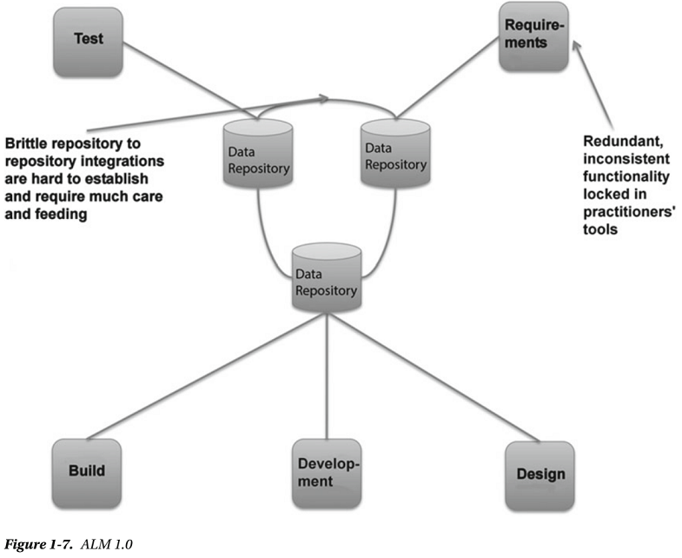
Figure 1-7

Slide 43
ALM 1.0 Tools
Tools have also been centered on one discipline.
In real life, a project member working as a developer, for instance, often also acts as an architect or a tester.
Because the people in each of these disciplines have their own tool (or set of tools), the project member must use several tools and switch between them.
It could also be that the task system is separated from the rest of the tools, so to start working on a task, a developer must first retrieve the task from the task system—perhaps they must print it out, or copy and paste it, then open the requirements system to check the requirement, then look at the architecture in that system, and finally open the development tool to begin working.
Hopefully the testing tools are integrated into the development tool; otherwise, yet another tool must be used.
All this switching costs valuable time that could be better put into solving the task.
Having multiple tools for each project member is obviously costly as well, because everyone needs licenses for the tools they use.
Even with open source tools that may be free of charge, you have maintenance costs, adaptions of the tools, developer costs, and so on.
Maintenance can be very expensive, so you shouldn’t forget this even when the tools are free. Such a scenario can be very costly and very complex. It’s probably also fragile.

Slide 44
ALM 1.0 Tools |
As an example, take two co-workers at a large medical company in Gothenburg.
They have a mix of tools in their everyday work.
We asked them to estimate how much time they needed to switch between tools and transfer information from one tool to another.
They estimated that they spend half an hour to an hour each day syncing their work.
Usually they’re on the lower end of that scale, but in the long run all the switching takes a lot of time and money.
Our friends also experience problems whenever they need to upgrade any of the systems they use.
One other problem with traditional ALM tools that’s worth mentioning is that vendors often add features: for example, adapting a test tool to support issue and defect management.
In the issue management system, some features may have been added to support testing.
Because neither tool has enough features to support both disciplines, users are confused and don’t know which tool to use.
In the end, most purchase both, just to be safe, and end up with the integration issues described earlier.

Slide 45
Application Lifecycle Management 2.0
Let’s look at what the emerging tools and practices (including processes and methodologies) in ALM 2.0 try to do for you.
ALM is a platform for the coordination and management of development activities, not a collection of lifecycle tools with locked-in and limited ALM features.
Figure 1-8 and Table 1-1 summarize these efforts.
One of the first things you can see is a focus on plug-ins. This means from one tool, you can add the features you need to perform the tasks you want, without using several tools!
If you’ve used Visual Studio, you’ve seen that it’s straightforward to add new plug-ins to the development environment.
Support for Windows Communication Foundation (WCF) and Windows Presentation Services , for example, was available as plug-ins long before support for them was added as part of Visual Studio 2008.
Having the plug-in option and making it easy for third-party vendors to write plug-ins for the tool greatly eases the integration problems discussed earlier.
You can almost compare this to a smorgasbord, where you choose the things you want. So far this has mostly been adopted by development tool vendors such as IBM and Microsoft, but more plug-ins are coming.
IBM has its Rational suite of products, and Microsoft has Team Foundation Server.

Slide 46
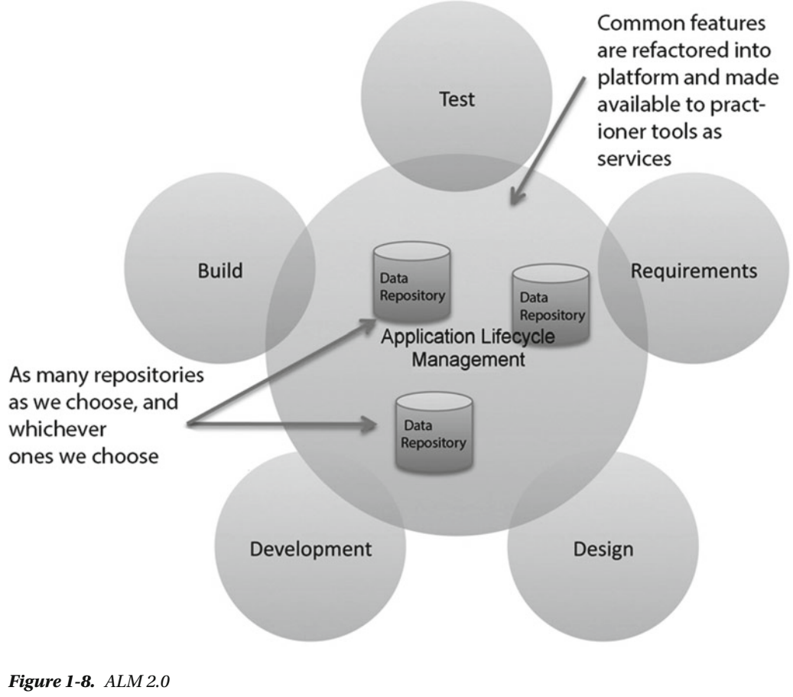
Figure 1-8

Slide 47
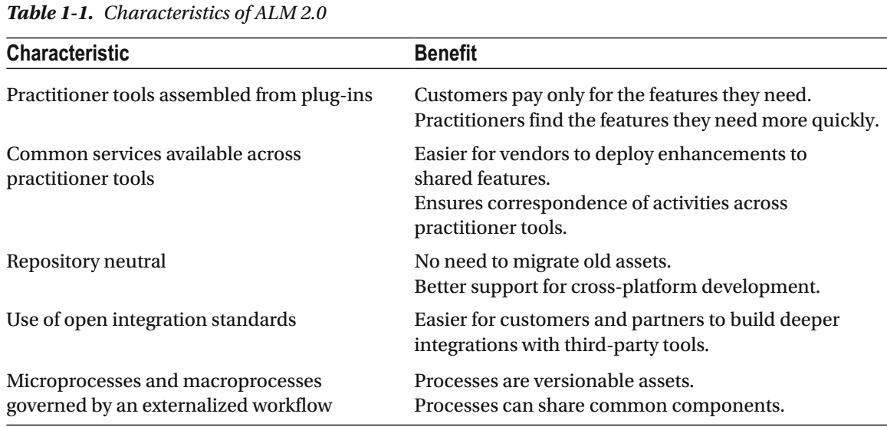
Table 1-1

Slide 48
Common Features
Another thing that eases development efforts is that vendors in ALM 2.0 focus more on identifying features common to multiple tools and integrating them into the ALM platform, including the following:
Collaboration
Workflow
Security
Reporting and analysis
Another goal of ALM 2.0 is that the tools should be repository neutral.
There should be not a single repository but many, so you aren’t required to use the storage solution that the vendor proposes.
IBM, for example, has declared that its forthcoming ALM solution will integrate with a wide variety of repositories, such as Concurrent Versions System (CVS) and Subversion, just to mention two.
This approach removes the obstacle of gathering and synchronizing data, giving you easier access to progress reports, and so on.
Microsoft uses an extensive set of web services and plug-ins to solve the same issue.
It has one storage center (SQL Server); but by exposing functionality through the use of web services, Microsoft has made it fairly easy to connect to other tools as well.

Slide 49
Common Features |
An open and extensible ALM solution lets companies integrate their own choice of repository into the ALM tool.
Both Microsoft and IBM have solutions—data warehouse adapters—that enable existing repositories to be tied into the ALM system.
A large organization that has invested in tools and repositories probably doesn’t want to change everything for a new ALM system; hence it’s essential to have this option.
Any way you choose to solve the problem will work, giving you the possibility of having a well-connected and synchronized ALM platform.

Slide 50
Standards
Furthermore, ALM 2.0 focuses on being built on an open integration standard.
As you know, Microsoft exposes TFS functionality through web services.
This isn’t publicly documented and isn’t supported by Microsoft, however, so you need to do some research and go through some trial and error in order to get it working.
This way, you can support new tools as long as they also use an open standard, and third-party vendors have the option of writing cool and productive tools.
Process support built in to the ALM platform is another important feature. By this we mean having automated support for the ALM process built right into the tool(s).
You can, for instance, have the development process (RUP, Scrum, XP, and so on) automated in the tool, reminding you of each step in the process so you don’t miss creating and maintaining any deliverables or checkpoints.
In the case of TFS, this support includes having the document structure, including templates for all documents, available on the project web site as soon as a new TFS project is created.
You can also imagine a tool with built-in capabilities that help you with requirements gathering and specification.
For instance, you can add requirements and specs to the tool and have them transformed into tasks that are assigned to the correct role without your having to do this manually.

Slide 51
ALM 2.0 Benefits
An organization isn’t likely to scrap a way of working just because the new ALM tool says it can’t import that specific process.
It has often invested a lot of money into developing that process, and the organization won’t want to spend the same amount again to learn a new one.
With ALM 2.0, it’s possible to store the ALM process in a readable format such as XML.
The benefits include the fact that the process can be easily
Modified
version controlled
reported on
The ALM platform can then import the process and execute the application development process descriptions in it.
Microsoft, for example, uses XML to store the development process in TFS.
The process XML file describes the entire ALM process, and many different process files can coexist.
This means you can choose which process template you want to base your project on when creating a new project.

Slide 52
ALM 2.0 Benefits |
As you saw earlier, it’s important for an enterprise to have control over its project portfolio, to better allocate and control resources.
So far, none of the ALM vendors has integrated this support into the ALM platform. There may be good reasons, though.
For instance, although portfolio management may require data from ALM, the reverse probably isn’t the case.
The good thing is that having a standards-based platform makes integration with PPM tools much easier.

Slide 53
Application Lifecycle Management 2.0+
So far, not all ALM 2.0 features have been implemented by most of the major ALM tool vendors.
There are various reasons. One is that it isn’t easy for any company to move to a single integrated suite, no matter how promising the benefits may appear.
Making such a switch means changing the way you work in your development processes and maybe even throughout your company.
Companies have invested in tools and practices, and spending time and money on a new platform can require considerably more investment.
For Microsoft-focused development organizations, the switch might not be as difficult, however—at least, not for the developers.
They already use Visual Studio, SharePoint, and many other applications in their daily life, and the switch isn’t that great.
But Microsoft isn’t the only platform out there, and competitors like IBM, Serena, and HP still have some work to do to convince the market.
In addition, repository-neutral standards and services haven’t evolved over time.
Microsoft, for instance, still relies on SQL Server as a repository and hasn’t built much support for other databases or services. The same goes for most competition to TFS.

Slide 54
Application Lifecycle Management 2.0+ |
The growth of agile development and project management in recent years has also changed the way ALM must support development teams and organizations.
There has been a clear change from requirements specs to backlog-driven work, and the tooling you use needs to support this change.
It becomes critical for ALM tools to support agile practices such as build-and-test automation.
TDD is being used with increasing frequency, and more and more developers require their tools to support this way of working.
If the tools don’t do that, they’re of little use to an agile organization. Microsoft has taken the agile way of working to heart in the development of TFS; this book shows you all you need to know about TFS’s support for agile practices.
There has also been a move from traditional project management toward an agile view where the product owner and Scrum master require support from the tools.
Backlog grooming (the art of grooming requirements in the agile world), agile estimation and planning, and reporting—important to these roles— need to be integrated into the overall ALM solution.
The connection between operations and maintenance also becomes more and more important. ALM tools should integrate with the tools used by these parts of the organization.

Slide 55
Application Lifecycle Management 2.0+ ||
In the report “The Time Is Right for ALM 2.0+,” Forrester research presented the ALM 2.0+ concept, illustrated in Figure 1-9.
This report extended traditional ALM with what Forrester called ALM 2.0+.
Traditional ALM covers traceability, reporting, and process automation, as you’ve seen.
Forrester envisions the future of ALM also including collaboration and work planning.
These concepts are essential throughout the rest of this book: A chapter is dedicated to each one except for traceability and visibility that are combined into one chapter since they are closely related.
The book’s focus is on ALM 2.0+, but it includes some other older concepts as well.
We’ve already looked at the first three cornerstones, but let’s briefly examine the two new ones introduced in ALM 2.0+:
Work planning: In this concept Forrester includes planning functions, such as defining tasks and allocating them to resources.
These planning functions shouldn’t replace the strategic planning functions that enterprise architecture and portfolio management tools provide.
Instead, they help you execute and provide feedback on those strategic plans.

Slide 56
Application Lifecycle Management 2.0+ |||
Integration of planning into ALM 2.0+ helps you follow up on projects so you can obtain estimates and effort statistics, which are essential to all projects.
Collaboration: This is essential. ALM 2.0+ tools must support the distributed development environment that exists in many organizations.
The tools must help team members work effectively—sharing, collaborating, and interacting as if they were collocated.
The tools should also do this without adding complexity to the work environment.
We take a closer look at these topics further down the road.
But before that, we examine a new topic on the horizon: DevOps.
It’s important because it has the potential to solve many ALM problems.

Slide 57
NOTE
Virtually all vendors use ALM tools to lock in customers to as many of their products as possible—especially expensive major strategic products like RDBMS.
After all, these companies live mostly on license sales.

Slide 58
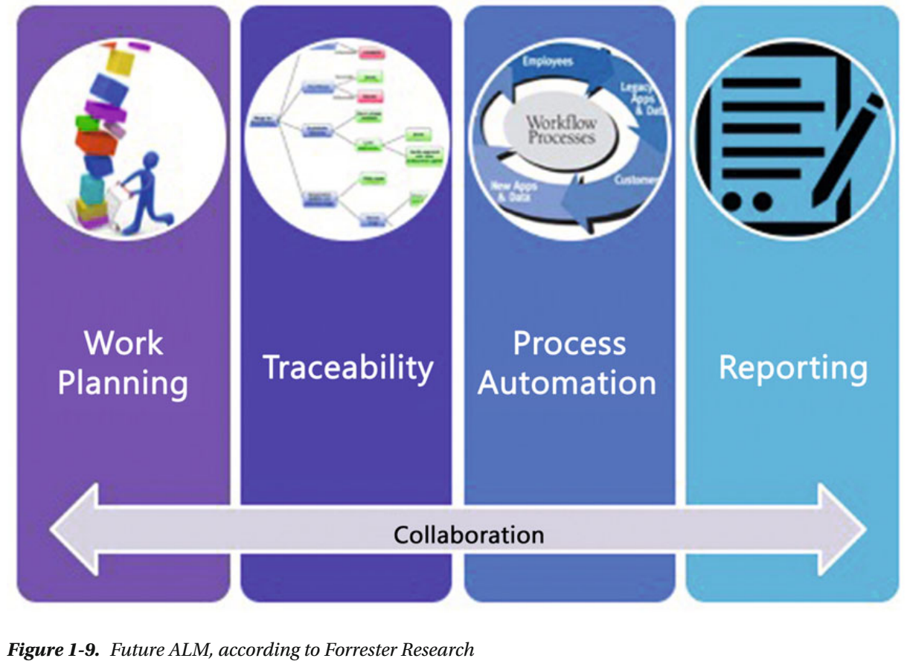
Figure 1-9

Slide 59
DevOps
The last couple of years have seen the concept of DevOps emerge.
In our view, DevOps is close to, or even the same as, the unified view of ALM presented earlier in the chapter.
One big difference compared to a more traditional approach is that DevOps brings development and operations staff closer not just in thought but also physically.
Because they’re all part of the DevOps team, there is no handover from one part to the other—team members work together to deliver business value through continuous development and operations.
Figure 1-10 shows how Microsoft looks at DevOps.
DevOps isn’t a method on its own ; instead, it uses known agile methods and processes like Kanban and Scrum, which are popular in many IT organizations.
Basically, these are project-management methods based on agile concepts and are used for development (mostly Scrum) and operations (mostly Kanban).
The key concepts are

Slide 60
DevOps |
What is important is working with small changes instead of large releases (which minimizes risk), getting rid of manual steps by automating processes, and having development and test environments that are as close as possible to the production environment.
The purpose of DevOps is to optimize the time from the development of an application until it’s running stably in the production environment.
The quicker you can get from idea to production, the quicker you can respond to changes in, and influences from, the market—which is crucial in order to have a successful business.

Slide 61
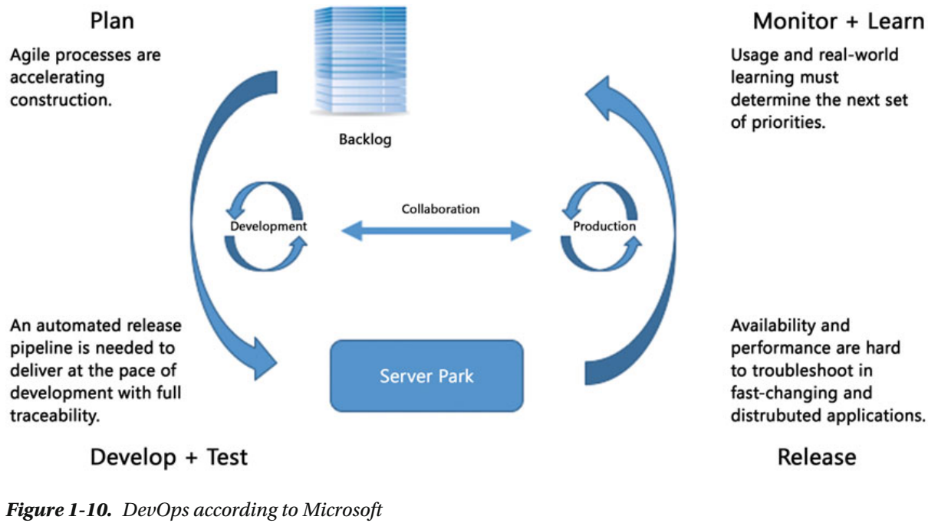
Figure 1-10

Slide 62
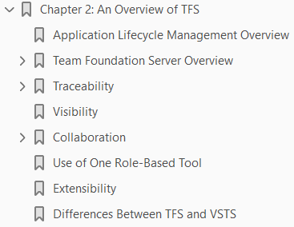
2
An overview of TFS

Slide 63
Intro
This chapter discusses a tool that will make it clear why ALM is an important process for organizations engaged in IT development.
A good implementation of ALM will help the organization deliver better business value to fulfill its business needs.
Automating tasks by using tools such as Visual Studio 2015 and Team Foundation Server (TFS) 2015 can support this process.
In this chapter, you will learn how TFS can be used to fulfill the three main pillars of ALM and the issues addressed by ALM, which we covered in Chapter 1.
We will start with an overview of ALM and of TFS and then move on to the specifics of using TFS for ALM.

Slide 64
ALM Overview
As you may recall from Chapter, there are three main pillars of an ALM process:
Traceability of relationships between artifacts: The lack of traceability can be a major cost driver in any enterprise.
There must be a way of tracing the requirements all the way to delivered code and back again—through
architect models
design models
build scripts
unit tests
test cases and so on
Practices such as test-driven development and configuration management can help, and these can be automated and supported by TFS.
Automation of high-level processes: There are approval processes to control handoffs between analysis and design.
There are other handoffs among build, deployment, testing, and so on.
Much of this is done manually in many projects, and ALM stresses the importance of automating these tasks for a more effective and less time-consuming process.

Slide 65
ALM Overview |
Visibility into the progress of development efforts: Many managers and stakeholders have limited visibility into the progress of development projects.
Their visibility often comes from steering group meetings during which the project manager goes over the current situation.
Other interest groups such as project members may also have limited visibility of the whole project even though they are part of it.
This often occurs because reporting is hard to do and can involve a lot of manual work.
Daily status reports can quite simply take too much time and effort to produce, for example, especially when we have information in many repositories.

Slide 66
Other ALM Features
Other important topics that ALM addresses are as follows:
Improving collaboration: Collaboration is needed between teams, team members, stakeholders, and users, just to mention a few relationships.
When development is spread around the world in different locations, collaboration can be hard to manage without the help of a proper tool.
Closing the gap between IT and business: The big gap between IT and the business side of an organization is a serious problem for organizations, preventing companies from delivering the greatest business value they can achieve in their projects.
Using one tool: The complexity of using several tools for solving project issues as a team member can be tough and costly as well.
Switching between tools can be a cost driver. Using one tool to add plug-ins and use more features directly in an ordinary GUI instead of switching between applications is preferable.
So, if you have several roles in a project, you can still use one tool to get the job done.
Enhancing role switching: ALM also addresses the potential to use one tool when switching among different roles in a project.

Slide 67
Other ALM Features |
In many cases, project members play several roles in projects.
A developer, for instance, might also work with tests or databases.
If that person can use the same GUI for all tasks, there will be minimal overhead for switching between these roles.

Slide 68
Team Foundation Server Overview
TFS has come a long way toward fulfilling the ALM vision, but it does not cover everything.
TFS is an open and extensible product that will let you adjust its features to your needs and add the things it might lack at this point to support your specific needs.
It is also important to know that Microsoft is spending a lot of time, energy, and money on developing this product further.
It is not a toolset that will go away quickly (although one never knows); it is one of the most important toolsets in the Microsoft ecosystem.
TFS is now available in two versions;
Team Foundation Server (TFS) and
the cloud-based Visual Studio Team Services (VSTS)
This book uses both versions for illustrations.

Slide 69
Team Foundation Server
You can see that the heart of ALM in the Visual Studio 2015 world is TFS 2015 or if you use the cloud-based version, Visual Studio Team Services (formerly known as Visual Studio Online), as shown in Figure 2-1.
TFS exposes different functions and services for developers, project managers, and others like
Version Control
Reporting
Build and Work Item tracking
Not shown in the image is that TFS uses Microsoft SQL Server as its data repository.

Slide 70
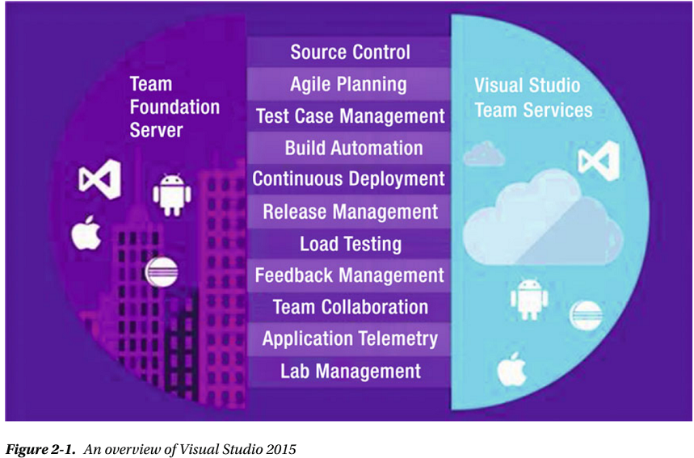
Figure 2-1

Slide 71
NOTE
Work items (Figure 2-2 ) are used to manage different types of information in TFS.
We have work items for
Requirements
Bugs
General tasks and so on
To put it simply, a work item is a piece of work that must be completed in a project.
The work item tracking system is one of the core parts of TFS for ALM process implementation.

Slide 72
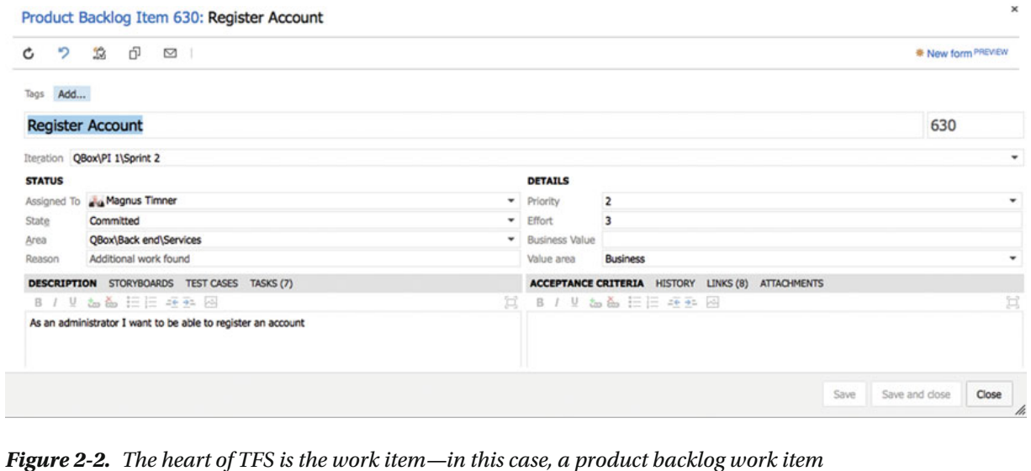
Figure 2-2

Slide 73
Process Template
What keeps all of these services together is the process template (see Figure 2-3 ) that sits on top of TFS/VSTS.
This is a very interesting part of TFS.
The template helps you visualize and automate tasks and steps that the process includes.
It helps you by providing document templates for
requirements specs
test cases
Scenarios
Handoffs
other artifacts you should produce
Most companies use some kind of process for their development or ALM.
Even though some companies don’t think they have a process, they do.
The process might not be written down, but the company still has ways of doing things that in reality is the process—for instance, naming conventions, where to store builds, how to handle change requests, and so on.
In many cases, we have seen companies with lots of money invested in their processes.

Slide 74
Process Template |
They have sent staff to training, provided large process manuals, and so on.
However, they’ve had problems getting project members to actually use the processes in their daily work.
The excuses are many: the process is
hard to understand
remembering all the process steps is difficult
the process is not automated or included in the tools and many others

Slide 75
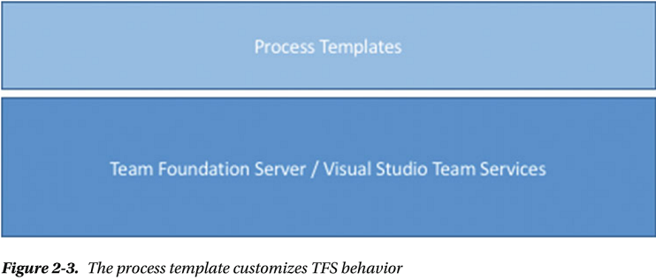
Figure 2-3

Slide 76
Process Variants
The end result has been that project members use their own variant of the process, causing confusion during the project’s lifetime.
This also causes severe problems, as handoffs between the development team and the operations team are often difficult.
A typical bad scenario can occur when a system has to wait for deployment because the infrastructure isn’t in place for the new system.
Operations was not involved (or perhaps even informed) during the project and suddenly they are expected to run the system on hardware they don’t have.
In TFS, you can implement your development process as a template that will be mandatory for all new projects.
When you create a new project, you also create a new instance of the process template.
You don’t have to stop at the development project level either.
You can implement most parts of the ALM cycle in the template as well, enabling you to take advantage of TFS all along the way.
The template helps you visualize and automate tasks and steps that the process includes.

Slide 77
Process Variants |
It helps you by providing document templates for
requirements specs
test cases scenarios
Handoffs
other artifacts you should produce
The template also provides information about which reports you have available for each new project— reports that you’ll use to retrieve information about the status of projects and many other things.
The template also contains information about one of the most important core parts of TFS: the work items.
These can be adjusted as needed so you can make sure they contain the information the organization must have included with them.
This information could be status information for a bug, for instance, such as
Active
Resolved or
Closed

Slide 78
Process Variants ||
This template is so flexible that
you can develop and implement your own process
you can choose to use any of the three that Microsoft supplies,
you can use a third-party template or
you can choose to customize the Microsoft templates to your own liking
You can also have several process templates in TFS so you can use different templates for different projects.
Because TFS is not used to its full potential without the process templates, we cannot stress enough that you should consider which templates you want to use and the information you want them to include.

Slide 79
Visual Studio 2015 Editions
Most developers will use Visual Studio to access the features of TFS.
There are several editions available:
Visual Studio Community: Full-featured IDE for building web, Windows desktop and cross-platform iOS, Android, and Windows apps.
This edition is free for open source projects, academic research, training, education, and small professional teams.
Visual Studio Professional: Professional developer tools and services for individual developers or small teams.
Powerful features to improve your team's productivity such as CodeLens.
Improve team collaboration with agile project planning tools, team rooms, charts, and more.
Visual Studio Enterprise: Enterprise-grade solution with advanced capabilities for teams working on projects of any size or complexity, including advanced testing and DevOps.
Build quality applications at scale with advanced features such as load testing, automated and manual testing, and IntelliTest capabilities.
Manage complexity and resolve issues quickly with features such as Code Map and IntelliTrace.

Slide 80
Visual Studio 2015 Editions |
Visual Studio Test Professional: This is the tool for testers.
These tools are also included in the Ultimate edition but it lacks the development tools included in the other editions.
Team Explorer Everywhere: Enables developers on other platforms like Eclipse on the Mac to access TFS.
This is the perfect add-on for teams with development on multiple platforms like .NET and Java.

Slide 81
TFS Web
All projects in TFS have their own web sites available.
By using Windows SharePoint Services or Server, a team project portal is created when the project itself is created.
By using this portal, or the more advanced Team System Web Access, you can access most of the functionality in TFS.
The project portal lets you access the parts of TFS that are available from inside Visual Studio, from an easy-to-use interface, especially for non-technical project members.
Figure 2-4 shows what Web Access could look like.
Many of our customers use a team project portal primarily to provide access to reports and work items for non-technical people not used to the Visual Studio interface.
When we want to give an external user (such as a customer or remote stakeholder) access to work item creation and editing, or another more advanced task, we typically use Web Access.

Slide 82
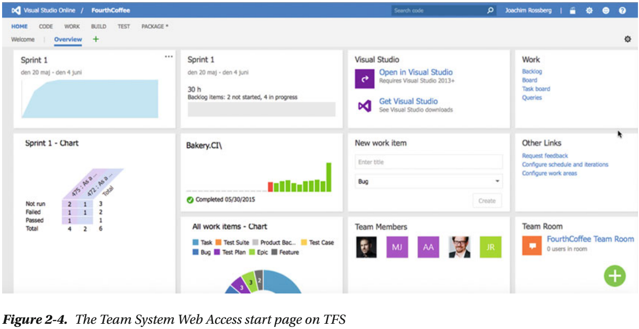
Figure 2-4

Slide 83
Microsoft Office
Microsoft Office can be used by
project managers
product owners
Scrum masters
for example, wishing to use tools that are familiar to them, such as Microsoft Project and Microsoft Office Excel, during a project.
The integration is very nice and valuable to these roles.

Slide 84
IDE Integration
When it comes to add-ons, one thing we should mention in particular is the Team Explorer.
This tool can be used as an add-on to Visual Studio, and it gives access to TFS directly from within Visual Studio.
From here you can
open reports
add new work items
run queries against the TFS database
TFS is a flexible tool, as we have mentioned. It is also very extensible, as all functionality can be accessed via web services.
This is a very nice feature that enables you to build your own support for TFS in other applications, as well.
Many third-party vendors have done this, and a wide array of add-ons and tools are available.
Our favorite came from Teamprise, a company that has built add-ons to Eclipse so that we can use TFS features in our Java development environment as well.

Slide 85
IDE Integration |
Teamprise was purchased by Microsoft, and its suite of client applications has been available as Team Explore Everywhere since TFS 2010.
It offers the same IDE integration into both Eclipse and Visual Studio, allowing you to truly work as one team, no matter whether you use Eclipse or Visual Studio.

Slide 86
Traceability
Having traceability in your ALM processes is key to the successful delivery and maintenance of applications and systems.
I once visited a company that stopped making changes to its systems just because no one ever knew where a change (or bug fix) might have its impact.
You don’t have to live with such a situation.
These TFS features can help you with traceability so you can avoid such problems:
Work item tracking
Test-driven development/unit testing
Automated builds/continuous delivery
Check-in policies
Version-control system
Let’s look at some of the specifics involved with these features, starting with how the work item tracking system implements traceability.

Slide 87
The TFS Work Item Tracking System
Sometimes it seems like we have tons of Post-its on our monitors and desks—each one containing at least one task we are supposed to take care of.
We would like to track them in a tool that could help us, but often it just isn’t possible.
It could be that some tasks are connected with one project, others with another.
We have tried writing them all down in an Excel spreadsheet and saving that to the computer.
But soon we find that this spreadsheet is located on our laptops, our customer’s computer, our desktops, another customer computer, and so on.
And we have no idea which one is the current version. The same thing often occurs in projects.
Project managers have their to-do lists for a project, and they all have their own way of keeping them updated.
Let’s say a project manager (PM) uses Excel to keep track of these tasks—the status of tasks, to whom they are assigned, and so on.
How can the PM keep the team updated with the latest to-do list? If the PM chooses to e-mail it, chances are that some people won’t save the new version to disk or will just miss it in the endless stream of e-mail coming into their mailboxes.
Soon there are various versions floating around, and things are generally a mess.

Slide 88
Work Items
TFS has a task-tracking system at your service.
We will take a closer look at work items in Chapter 4, so we will keep it brief here.
The core of this system is represented by the tasks themselves, which as we said earlier are called work items.
A work item can be pretty much what you want it to be. It can be a bug, a requirement of some sort, a general to-do item, and so on.
Each work item has a unique ID that helps you keep track of the places it is referenced (see Figure 2-5 ).
The work item ID (60 in Figure 2-5 ) lets you follow a work item, let’s say a requirement, from its creation to its implementation as a piece of executable software (component).
Work items provide a great way for you to simplify task management in a project while at the same time enabling traceability.
No more is there confusion as to which version of the task list is the current one; no more manual labor for gathering status reports on work progress that are used only at steering group meetings.
Now you have a solution that lets you collaborate more easily with your teams and enables all members and stakeholders to view status reports whenever they want.
You can also more easily collaborate with people outside the project group by adding work items via the web client.

Slide 89
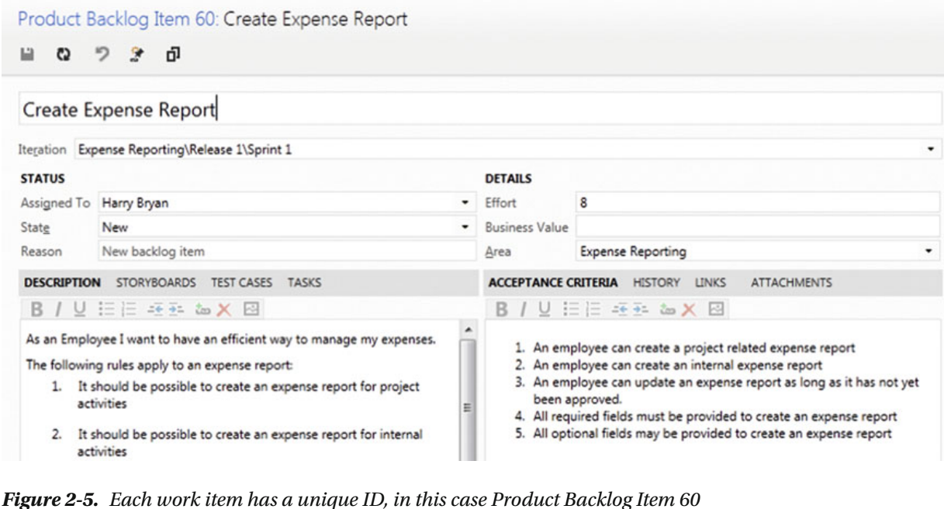
Figure 2-5

Slide 90
Work item Tracking System
TFS is so flexible in this regard that it lets you tailor the work items as you want them to be.
The work item tracking system is one of the core components of TFS.
This system enables you to create work items, or units of work, and can be used to enable traceability.
You can use the work items included with TFS from the beginning, or you can choose to adjust these to your needs, or even create your own work item types.
Each work item instance has a unique ID that you can attach to the things you do in TFS.
This enables you to follow one work item—let’s say a requirement, for example—from its creation to its implementation as a piece of executable software (component).
You can also associate one work item with others and build a hierarchy of work items.
The work items can contain information in different fields that define the data to be stored in the work item. This means that each field will have a name and a data type.
All work items can have different information attached to them.
You can have information about to whom the work item is assigned and the status of the work at the moment (for example, a bug could be open, closed, under investigation, resolved, and so on).
The State field can be modified so that each work item type can have its own state mechanism.

Slide 91
Work item Tracking System |
This is logical because a bug probably goes through states different from those that a general task goes through, for instance.
You can also attach documents to the work item and link one work item to other work items. You can even create a hierarchy of work items if you want.
Let’s say that you implement a requirement as a work item and that this requirement contains many smaller tasks.
Then you can have the requirement itself at the top and nest the other requirements below that so you know which work items belong to which requirement.
When a bug is discovered, for instance, you can quickly follow the original requirement by its work item ID and see in which places in the code you might have to make some fixes.
You can also see the associated work items so that you can evaluate whether other parts of the code need to be changed as a result of this bug fix.
TFS saves information about the work item on the data tier, which helps you follow the change history of the work item. You can see who created it, who resolved it, who closed it, and so on.
The information in the databases can be used for display on reports, allowing you to tailor these depending on your needs.

Slide 92
Work item Tracking System ||
One report could show the status of all bugs, for instance.
Stakeholders can see how many open bugs exist, how many are resolved, and much, much more
It is completely up to you and your organization how you choose to use the work items
If you implement a requirement as a work item, you can use the work item ID to track this requirement through source code and to the final build of the executable system.
By requiring all developers to add one or more work item IDs to the check-in using a check-in policy, you can enable this traceability.

Slide 93
Configuration Management Using TFS
In any (development) organization, you need to have control of the versions of your systems you have in production.
If you don’t have that, the overall ALM process will suffer, because you will suddenly lose traceability.
This will make it harder to implement changes and bug fixes, because you won’t know which versions you need to update.
Without the help of a proper tool, you soon will get lost in the variety of applications you have.
TFS can help you with this in many ways.
After a brief description of software configuration management, I will cover three of the most important concepts that have great support in TFS and Visual Studio tools:
Version control
Release management
Build management

Slide 94
NOTE
In software engineering, software configuration management (SCM) is the task of tracking and controlling changes in the software.
Configuration management practices include revision control and the establishment of baselines and are very important.
There are several goals of SCM, including the following:
Configuration identification: Ensuring that you know what code you are working with
Configuration control: Controlling the release of a product and its changes (version control)
Build management: Managing the process and tools used for builds
Defect tracking: Making sure every defect has traceability back to the source
If these issues are not covered by your ALM process, you could very soon find yourself in a troublesome situation.
It is crucial for the development teams to have full control over which versions of the applications exist, which are in production, and where.
This topic is closely related to the portfolio management team, and generally a big company has one or more persons devoted to keeping track of this.

Slide 95
Version Control & Release Mgmt: TFS 2015
Using the version-control system in TFS, you can manage and control multiple revisions of the same information in your projects.
This information can be source code, documents, work items, and other important information that you want to add version control to.
When you want to work on an item under source control, you check it out to your local computer so you can start working on it.
When work is done and tested, you check in your changes so the version on the server is updated.
The version-control features of Team Foundation Server 2015 are powerful.
They are fully integrated into the GUI, which is something that ALM prescribes as well. If you want to, you can access some of the features from a project portal as well.
Many people want to use the command line for their work, and TFS enables them to use the command line for working with version control as well.
However, if you do want to use Visual Studio to access the TFS version-control system, you can do that.
The extensibility of TFS makes this possible.
One example of this is the Team Explorer Everywhere suite of client applications that can access TFS, including the version-control system.

Slide 96
Version Control & Release Mgmt: TFS 2015 |
Teamprise has developed an Eclipse plug-in that lets users access TFS from Eclipse instead.
Teamprise also lets you access TFS from Mac OS X and Linux command lines.
This way, you can more easily integrate different development platforms in a TFS project.
You still will use the TFS repository and have the ability to get reports and other information directly from TFS.

Slide 97
Build Management
A build is basically the process of taking the source code and all other items necessary in an application and building it into executable software.
Team Foundation Build is the build engine in TFS and executes the build process as defined by the TFS settings.
Team Foundation Build is built on the Microsoft build engine (MSBuild), which is the build platform for Microsoft and Visual Studio.
You can attach unit tests to a build process so that you automatically run these every time the build process kicks off.
Team Foundation Build is fully integrated into the Visual Studio GUI so you don’t have to use separate tools for handling these tasks.

Slide 98
Builds supported by TFS
Team Foundation Build supports several types of builds:
Full builds: You build everything in the project. This can be resource- and time-consuming.
Partial builds: You build only one or more parts of the system.
Nightly builds: Many projects build the system during nighttime. Especially if the build process takes a long time, this can be very handy.
Custom builds: You can use the extensibility of TFS to create your own build types or edit any of the existing ones.
Incremental builds: You build only the components that have been changed since the last build.
You can also add a number of tasks that you want to be executed when running the build:
Get the latest source code from the version-control system
Compile sources
Perform architectural validation
Run static analysis tool
Execute unit tests
Update work items

Slide 99
Builds supported by TFS |
Perform code coverage
Calculate code churn (how many rows of code have been modified or added since the last count)
Produce build reports
Drop exe/output into predefined location

Slide 100
Automation of High-Level Processes
Without one or more templates, TFS will not be used to its full potential, as you saw earlier in this chapter.
You could still use its version-control system and some other tools, but the real value comes from using it to automate your ALM process.
In the process template, your whole ALM process is defined.
Chapters 5 and 6 cover a lot more on this topic as well.
The template defines the following:
Work item types: Which work item types are necessary and what information they should have attached to them.
You can also define the workflow for a work item. For a bug, you might have different states the item flows through, such as Active, Resolved, Closed, and so on.
Project phases: By using areas and iterations, you can define the initial project phase setup of your projects.
If you use RUP ( https://en.wikipedia.org/wiki/Rational_Unified_Process ), you can define the process phases in that model, or you can create the first sprints of a Scrum project.
Areas and iterations are flexible, and you can create your own way of working through these concepts.

Slide 101
Automation of High-Level Processes |
Document structure and templates: The number of documents that should be produced during a project will differ depending on your process model.
In the process template, you define the document structure you need and the templates you should use.
For instance, you can add templates for requirement specifications or acceptance testing here.
Reports and queries: In the process template, you can specify which reports and work item queries you need to have as defaults in your projects.
You probably want reports and queries showing the progress of your project, such as the status of bugs or work remaining.
You can create your own reports by using SQL Server Reporting Services or Excel and add them to all projects by adjusting the process template.
Security: The template also adds information about which users or user groups have access to what information.
You can connect TFS groups to your Active Directory accounts, for instance.
The process template is the overall process for your ALM implementation.
Many of our customers create different templates for different kinds of projects.

Slide 102
Automation of High-Level Processes ||
They also create templates for operations, so that when a development project is finished and deployed, the operations staff can use their template to run the system until the system dies.
A few customers have started creating a template for Information Technology Infrastructure Library (ITIL), for instance, and we are looking forward to seeing the result of that work.
It is important to remember that you can adjust the process to your needs.
You should consider changing the default templates or even replacing them, rather than adjusting your own way of working to the templates that come with TFS out of the box.
Microsoft enables this flexibility by letting you easily access the process templates to adjust them or to add new templates.

Slide 103
Visibility
Information about project status is important to all participants of a project—and we don’t mean team members only, but stakeholders and decision makers as well.
As project managers, we have spent too much time chasing down information to answer questions about the status of projects, how much work remains, and what the latest bug status is.
TFS provides two primary ways of enabling visibility:
Reports: Reports are created by using SQL Server Reporting Services (for more information, check out Pro SQL Server 2012 Reporting Services, 3rd Edition, by Apress) and accessing the TFS data tier directly.
You can define and adjust these as you want. You can also use Excel to create reports if you prefer.
Queries: Queries are used to ask questions of the work item tracking service.
One question might be how many bug work items you have. How many and which are dedicated to me? How many bugs are there? And so on.
You can create new queries when necessary.
By using these two components, it will be easier to gather the information you need for your status reports for a steering group meeting or project meeting.
You won’t have to look around in several places and in several applications for this information anymore; instead, you can use the automated reports and queries from inside TFS.

Slide 104
Visibility |
Project owners, project managers, and Scrum masters will certainly benefit from TFS.
Because TFS has all data in the same repository, you can more easily retrieve the correct information when you want it.
The flexibility of the SQL Server database that stores all information is great.
You can work with the data warehouse information just as you would with any other database.
By using the project portal or TFS Web (see Figure 2-6 ), you can publish information (in the form of custom-built controls that users cannot change at this time) so that everybody who has privileges can see them.
This is an easy way to make sure that information is available all the time.
Just this little, relatively non-technical improvement will off-load work from the project manager, freeing some of the PM’s or PO’s time for better things.

Slide 105
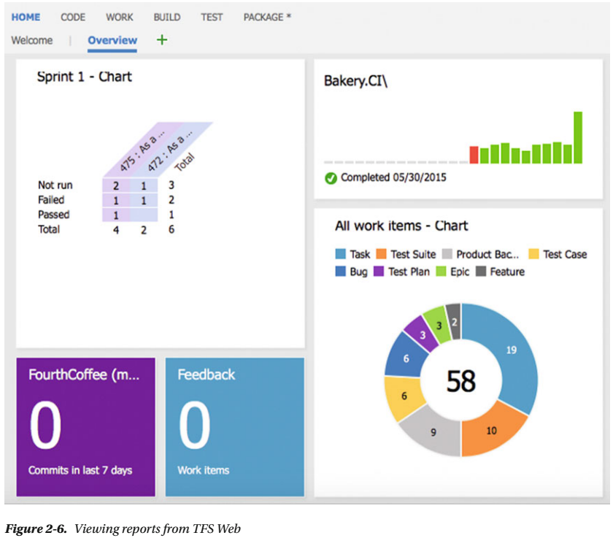
Figure 2-6

Slide 106
Collaboration
As you know, TFS comes with Team Explorer, which is an add-on to Visual Studio.
With this tool, the developer can access every aspect of a TFS project.
The developer can view reports and queries , for instance, as well as access the document in the project.
The developer can access the version control system as well as build systems, tests, and so on.
The Team Explorer is full featured but is still a tool for people used to working in Visual Studio.
For us that is no problem, but for most project managers and stakeholders, the GUI is confusing.
They want to have an easier-to-use tool to access the relevant information.
Each project that is created with TFS has a project portal created as well.
This portal provides access to reports, documents, project process guidance, and other project-related information through a web interface.
This enables people who are not used to the Visual Studio interface to easily retrieve the information they need.
There is also a collaboration site called team room (see Figure 2-7 ) that is created for each TFS Team Project.

Slide 107
Collaboration
This is a collaboration area where team members can chat, share information, and let TFS display information about different status aspects (such as how the nightly build went).
Collaboration, of course, does not only mean giving access to information, even though this is as important as any other means of collaboration.
Collaboration also means that you should be able to work together to fulfill one or more goals.

Slide 108
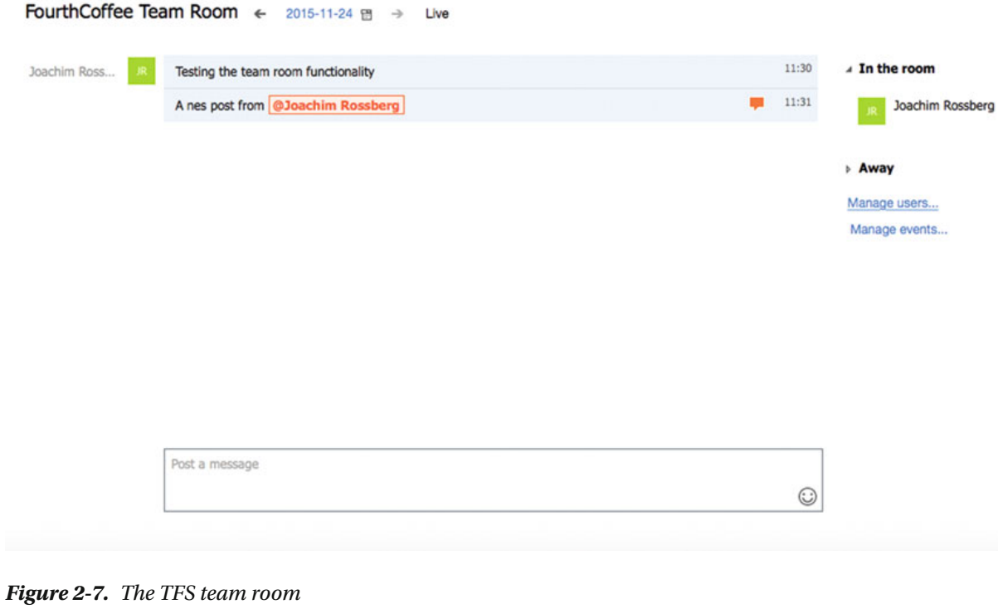
Figure 2-7

Slide 109
Work Items for Collaboration
You can use the work item features of TFS to enable your process workflows.
Let’s say a project manager, or anybody responsible for inputting requirements as work items into TFS, creates a new work item of the Scenario type.
This scenario should probably be assigned to a developer to implement.
The project manager uses the work item system to assign (see Figure 2-8 ) the scenario to a specific developer, in this case Joachim.
Joachim continues to work on the scenario until it is ready for testing.
He then assigns the work item to a tester who performs the testing. When the testing is done, the work item is perhaps closed.
If a bug is found, either the tester or anyone finding the bug can use the work item tracking system to see who developed the scenario implementation and reassign it to that developer, in this case, Joachim again.
TFS keeps track of who has worked on the work item so that you don’t have to manually keep track of this.

Slide 110
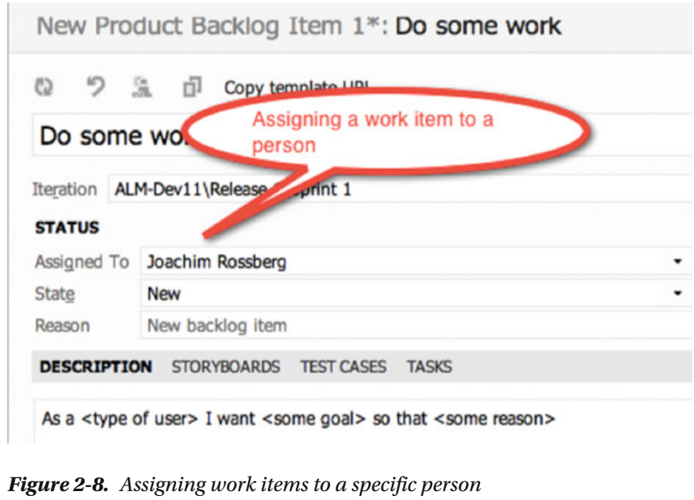
Figure 2-8

Slide 111
The Gap Between IT and Business
Closing the gap between IT and business is obviously a very tough problem to solve. TFS won’t get you all the way, that’s for sure.
We don’t think any tool ever will because so much depends on the people in the organizations, which is an important consideration.
But tools can help you bridge the gap, so you should carefully consider how you can use them for this. We need to improve on our ALM process and way of working to start solving this.
When we have a new way of working, TFS can support much of our efforts using, for instance, the process template to implement this new way of working.
The gap between the IT and business sides is often a question of work process.
It requires considering many things, and when you have a solution or start working toward a solution, you must evaluate which parts of this work process you can automate and use tools for solving.
One thing worth mentioning here is that the use of the TFS Project Server Connector with TFS lets you integrate TFS with Microsoft Office Project Server.
Having this integration will allow you to better control your resources and better automate this process as well.
This way, you can align your portfolio management process better so that you can choose which things to work on more effectively.

Slide 112
Office/MS Project Integration
When we have run projects in the past, we mostly used Microsoft Office Project to handle project planning, especially the Gantt diagram.
We suspect that this is the case for many of our fellow project managers as well.
In many cases, we have used this product not primarily because of the tool itself but because so many of our customers use Microsoft Office that it becomes natural for them to also use Project.
Project has its strengths and weaknesses, as all tools do, and we cannot say that we don’t like it, but we have never become friends with it.
Sometimes it does things that we don’t expect, and even though we know this is because we are not very familiar with its features, we still blame the product from time to time—unfair, but that’s life sometimes.
Excel and Project are two tools that most companies use on both the business and the IT sides of the company.
By being able to use these tools, business people can more easily be a part of the ALM process, because they can use a tool they are already used to working with.
A nice feature here is that the communication between Office and TFS is two-way. This means that an update in TFS will be reflected in Office and the other way around.
This allows for a dynamic way of working with TFS information.

Slide 113
Use of One Role-Based Tool
A good ALM tool should enable you to use add-ons that will provide new features inside one interface.
If a developer needs testing features, you should be able to integrate them into the development tool.
The developer should not have to switch tools to do testing tasks.
This is also what Visual Studio offers.
There is no context switching as team members can use the same GUI no matter what role they are performing at the moment.
TFS is also extensible and lets you create your own add-ons as well as purchase third-party add-ons that will be accessible from inside of TFS.

Slide 114
Extensibility
When the built-in features of TFS are not enough, you can use the extensibility features to expand and enhance it.
TFS is often seen as a closed black box that Microsoft ships, when it’s more like an enterprise resource planning (ERP) system for ALM.
Any ALM environment must be customized for an organization’s processes and the existing applications and services.
Many of our customers have been a bit reluctant to customize TFS.
They have instead tried to squeeze their way of working into the templates Microsoft provides with TFS.
We think this is the wrong way to do it. Our suggestion is that you start the other way around.
Start by asking yourself how your organization wants to work.
This process involves all parts of the organization, from the business side to operations.
Try to find agreement on how to work in the ALM process. By doing so, you will see that this also is a good start for collaboration in the company.
For instance, consider the work items and the information in them. If the fields and information in the MSF templates are not enough, extend or edit them.
TFS lets you do this by changing the process template.

Slide 115
Extensibility |
You can choose to add the information that you need, and it will be stored in the TFS databases, so you can have access to it from within your reports and queries.
Don’t forget to change the reports or queries, as well; otherwise, you will not see your information.
Some of our customers have changed the workflow of a work item by adding more states to it, when the ones supplied have not been enough.
Often we have used the TFS Power Tools to do this.
When you have an initial idea of how you want to conduct the ALM process, start looking into what TFS gives you out of the box.
Use what can be used, change other things, and build your own solution where needed.
One great strength of TFS is its extensibility and flexibility.
You can adjust the whole tool to fit most parts of your ALM process.
If you want to, you can develop your own add-ons by giving support to roles not included from the start.
We strongly encourage you to use these extensibility features, but in the end it is your choice.
Extensibility is a great way to integrate existing systems and potentially migrate some of them into TFS in order to reduce the toolset in the organization.

Slide 116
Differences Between TFS and VSTS
VSTS is cloud-based.
This is also the version of Team Foundation Server where Microsoft deploys all new features first.
Every three weeks Microsoft aims to update VSTS.
These updates are then packaged to a TFS update that is released approximately every three months.
Table 2-1 shows an overview of the difference in features between TFS and VSTS.
Keep in mind that the information in Table 2-1 will change as time goes by.
VSTS is updated every three weeks with new functionality and the differences between the two will probably diminish.

Slide 117
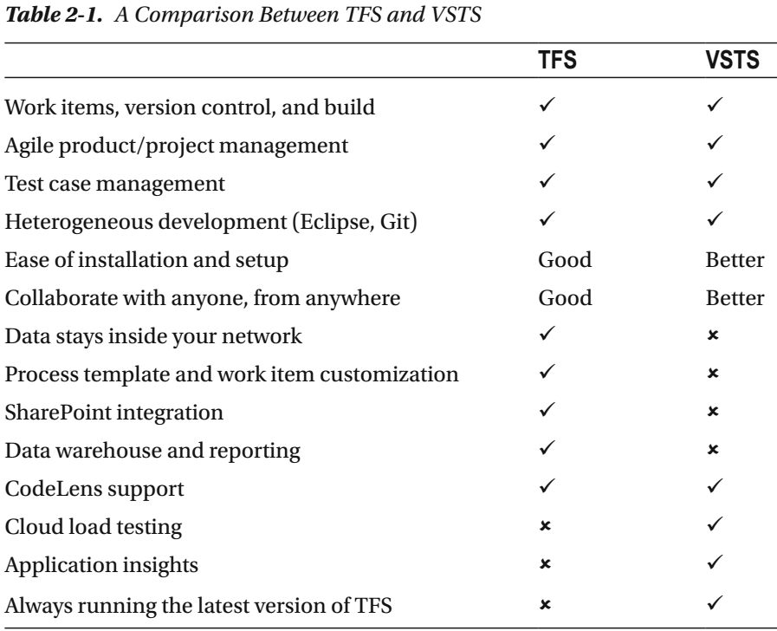
Table 2-1

Slide 118
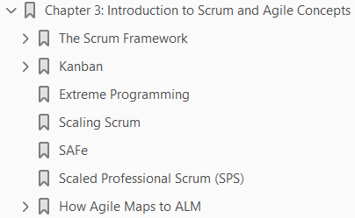
3
Introduction to Scrum and Agile Concepts

Slide 119
Intro
Our experience is that there has been a great deal of improvement in projects over the last decade.
To be more specific, we’ve seen the agile movement make an impact on how projects deliver business value.
The focus of this book, when it comes to processes and frameworks, is on agile methods like
Scrum
XP
The reason is simply that agile fits nicely with the concept of ALM.
This chapter looks at how you can use Scrum as an agile project-management model to deliver software.
We cover the Scrum process in-depth, including how you can use Scrum and agile practices such as agile estimation and planning in combination with an ALM tool.
This chapter gives you insight into why agile and ALM are a good match.
This chapter also shows you some other agile processes that are popular.
Scrum in itself is a great framework, but some projects and organizations need another process to help run their projects.

Slide 120
The Scrum Framework
Next is one of our favorite development models: Scrum.
With all the attention Scrum has been getting in recent years, you may be misled into believing it’s a fairly new model.
The truth is that the Scrum approach, although not called Scrum at the time, was first presented as “the rugby approach” in 1986.
In the January-February 1986 issue of the Harvard Business Review , Hirotaka Takeuchi and Ikujiro Nonaka described this approach for the first time.
In the article, they argued that small cross-functional teams produced the best results from a historical viewpoint.
It wasn’t until 1990, however, that the rugby approach was referred to as Scrum.
In 1990, Peter DeGrace and Leslie Hulet Stahl highlighted this term from Takeuchi’s and Nonaka’s original article.
The term comes from rugby originally (see Figure 3-1 ), where it means the quick, safe, and fair restart of a rugby game after a minor infringement or stoppage.

Slide 121
The Scrum Framework |
This is also the source of the following quotation: A scrum is formed in the field when eight players from each team, bound together in three rows for each team, close up with their opponents so that the heads of the front rows are interlocked.
This creates a tunnel into which a scrum-halt throws in the ball so that front-row players can compete for possession by hooking the ball with either of their feet” Keep this definition in mind as we describe the development version of Scrum.
Ken Schwaber started using Scrum at his company in the early 1990s. But to be fair, Jeff Sutherland was the first to call it Scrum.
Schwaber and Sutherland teamed up and presented this approach publicly in 1996 at Object-Oriented Programming, Systems, Languages, and Applications (OOPSLA) in Austin, Texas.
They collaborated to use their experience and industry best practices to refine the model until it achieved its present look.
Schwaber described the model in Agile Software Development with Scrum in 2001.
Let’s continue bay looking at empirical process control and see what that means in software development.

Slide 122
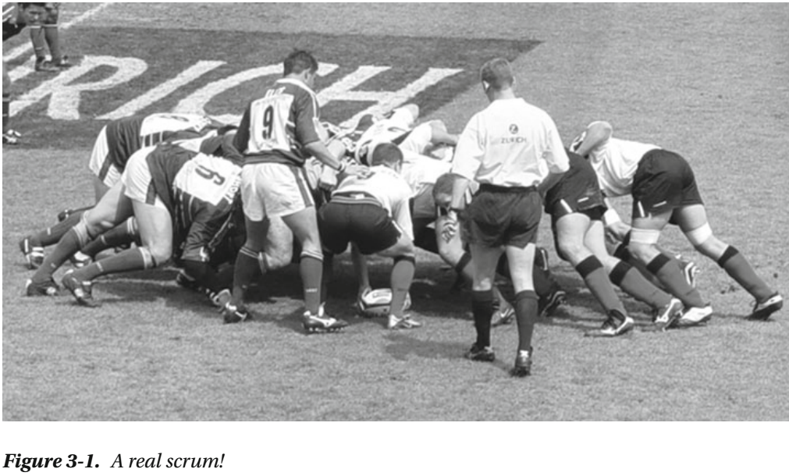
Figure 3-1

Slide 123
Empirical Process Control
What is this model, or framework, all about? First, let’s define two ways to solve problems.
We touched on the issues with projects in Chapter 1.
When you have an issue that is similar time after time (like road construction, for example, or implementing a standard system), you pretty much know what to expect from the various tasks at hand.
You can then easily use a process—the Waterfall model, perhaps—that produces acceptable-quality output over and over again.
This approach is called defined process control.
When it comes to a more complex problem, however, like building a software system, you saw earlier that the traditional models don’t work.
You then must use something called empirical process control, according to Schwaber.
Empirical process control has three legs to stand on:
Transparency
Inspection
Adaptation

Slide 124
Empirical Process Control |
Schwaber reuses the example of code review when he discusses empirical process control.
“The code is reviewed against coding standards and industry best practices.
Everyone involved in the review fully and mutually understands these
Standards
best practices
The code review occurs whenever someone feels that a section of code is complete.
The most experienced developers review the code, and their comments and suggestions lead to the developer adjusting his or her code.”
Simple, isn’t it? We could not have said it better ourselves.

Slide 125
Three Legs of Empirical Process Control
The Three Legs are explained below:
“Transparency means that the aspects of the process that affect the outcome must be visible to those controlling the process.”
This means to be able to approve the outcome, you must agree on the criteria for the outcome.
Two people can’t say they’re “done” with a task unless they both agree on what the criteria for “done” are.
The next leg is inspection. The process must be inspected as frequently as necessary to find unacceptable variances in it.
Because any inspection may lead to a need to make changes to the process itself, you also need to revise the inspections to fit the new process.
To accomplish this, you need skilled inspectors who know what they’re inspecting.
The last leg is adaptation. An inspection may lead to a change in the process: this is one example of an adaptation.
Another is that you must adapt the material being processed as a result of an inspection.
All adaptations must be made as quickly as possible to minimize deviation later.

Slide 126
Complexity in Projects
What makes a software development process so complex?
We discussed this a little previously, but let’s dive deeper here.
In theory, building a software system may seem pretty straightforward.
You write code that logically instructs the CPU to control the computer.
How hard can it be? Alas, it isn’t that simple, we’re afraid.
The people writing the code are complex machines in themselves.
They have different backgrounds, IQs, EQs, views, attitudes, and so on.
Their personal lives also add to their complexity.
The requirements may also be complex and have a tendency to change over time.
According to Schwaber, a large percentage of the requirements gathered at the beginning of a software project change during the project.
And 60% of the features you build are rarely or never used in the end.
Many times in our projects, several people at the customer site are responsible for the requirements.
Often they have diverging agendas as to why and what to build.
Often the stakeholders have a hard time expressing what they really want.

Slide 127
Complexity in Projects |
Only when they see a first prototype of the system do they fully begin to see the possibilities of the software, and only then can they begin to understand what they want.
Rarely is it the case that just one computer is involved in a system, either.
Generally there is interaction among several machines.
You may have
a web farm for your GUI
a cluster for your application tier
a backend SQL server
some external web services
often a legacy system
all needing to integrate to solve the needs of the new system
When complex things interact—as people, requirements, and technology do in a software project—the level of complexity increases greatly.
So it’s safe to say that we don’t have any simple software problems anymore.
They’re all complex.

Slide 128
Complexity in Projects ||
Schwaber realizes this as well.
Figure 3-2 shows his complexity-assessment graph.
The projects in the anarchy area are chaotic and unworkable.
To get them to their finish lines, you probably need to resolve serious issues before starting them.
What Scrum tries to do is address this inherent complexity by implementing
Inspection
Adaptation
Visibility
as you previously saw in the section “Empirical Process Control.
Scrum does so by having simple practices and rules.

Slide 129
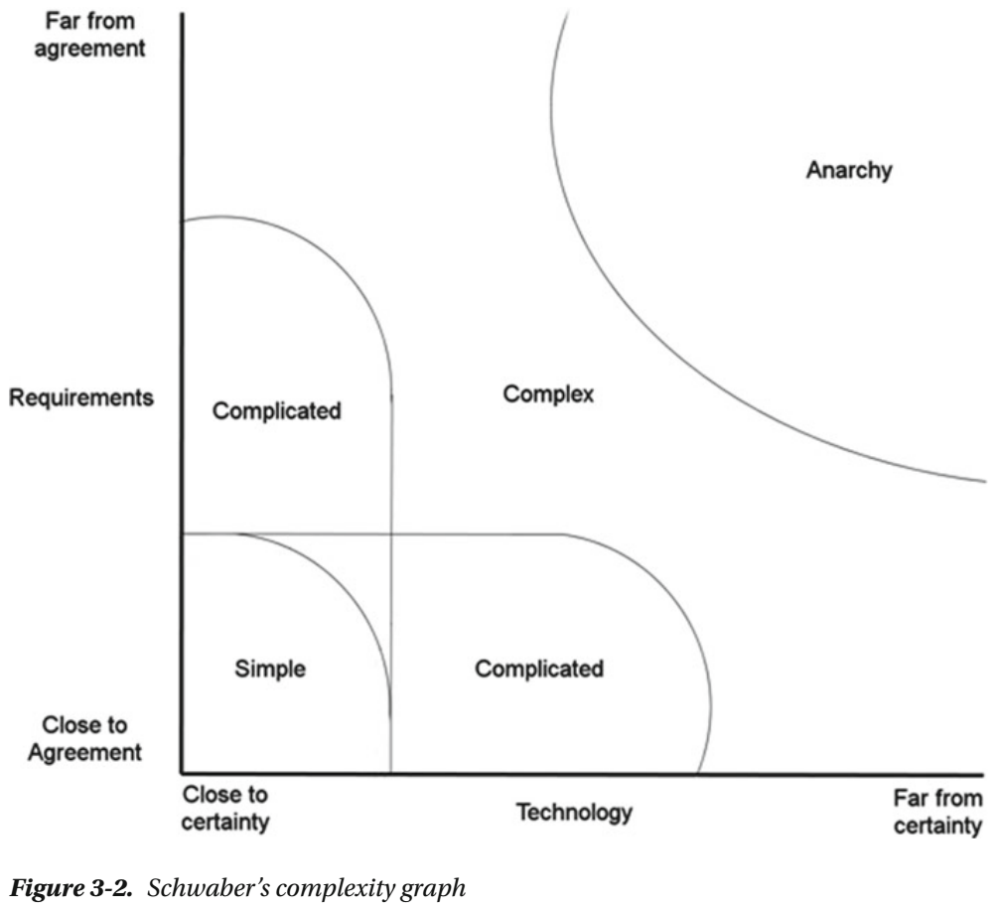
Figure 3-2

Slide 130
What Scrum Is
Scrum is a powerful, iterative, and incremental process.
Many are fooled by its perceived simplicity, but it takes time to master.
Figure 3-3 shows the skeleton of the Scrum model, to which we attach the
Rules
practices
In Scrum, you do development in time-boxed intervals called iterations.
An iteration is usually between two and four weeks.
Each iteration consists of daily inspections.
Such an inspection—or daily Scrum, is performed by the team once every day at a preset time.
During these inspections, team members evaluate each other’s work and the activities performed since the last inspection.
If necessary adjustments ( adaptations ) are found, they’re implemented as quickly as possible.
The iterations also conclude with inspections, when more adaptations can be made. This cycle repeats until it’s no longer funded.

Slide 131
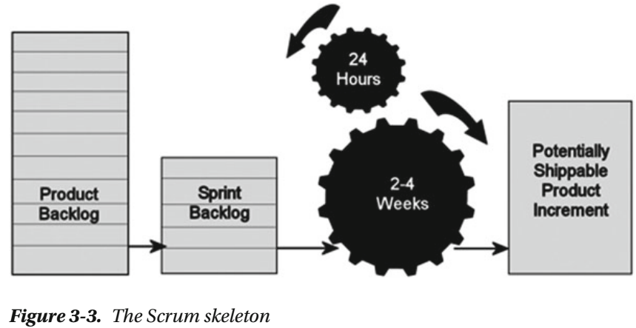
Figure 3-3

Slide 132
Product Backlog
All the requirements that are known at the beginning of the project are gathered in the product backlog, which is one of the artifacts of Scrum.
We come back to this shortly.
The project team reviews the backlog and selects which requirements should be included in the first iteration, or sprint, as it’s called in Scrum.
These selected requirements are added to the sprint backlog, where they’re broken down into more detailed items ( tasks ).
Later in the chapter, in Figure 3-9 , you can see how many teams visualize their work in a sprint using a Scrum board.
This can be electronic, as in the figure, or it can be a whiteboard with sticky notes.
The board shows the tasks that have been found for each backlog item and where in the development process each task is currently located (development, test, and so on).

Slide 133
Team
The team then makes its best effort to turn the sprint backlog into a shippable increment of the final product.
The team is self-managing, which means members collectively decide who does what and what the best way is to solve problems.
The increment is presented to the stakeholder(s) at the end of the sprint so they can inspect it and make any adaptations necessary to the project.
The sprint is most often 30 days, although as mentioned earlier, we often see sprints that last two to four weeks.
It depends on the sprint backlog items.
When I took his Scrum master certification, Ken Schwaber related that he once had a one-week sprint in a project.
The reason was that the team malfunctioned, and this way he could more easily catch the reason and adjust the process so the project ran more smoothly.
The stakeholders’ adaptations and feedback are put into the product backlog and prioritized again.
Then the team starts the process over and selects the backlog items they think they can finish during the next sprint.
These are put into the sprint backlog for the next sprint and broken down into more manageable items.

Slide 134
Team |
And so it continues, until the stakeholders think they have received the business value they want and funding stops.
If you look again at the three legs of empirical process control, you can see that Scrum covers them nicely.
Transparency is implemented by letting the team and stakeholders agree on the expected outcome of the project and of each iteration.
Inspection occurs daily and also at the end of each sprint.
Adaptations are the direct result of these inspections and a necessary thing in Scrum.

Slide 135
Roles in Scrum
Scrum incorporates different roles.
In other models, there are usually many more roles defined in a very strict way, but Scrum has only these three roles:
The Product Owner
The Team
The Scrum Master

Slide 136
The Product Owner
Let’s start with the product owner.
This person is responsible to those funding the project to deliver a product or a system that gives the best return on investment (ROI) he or she can get from the project.
The product owner must
acquire the initial funding for the project and
make sure it’s funded through its lifespan
The product owner represents everyone with a stake in the project and its result.
At the beginning of a project, the product owner gathers the initial requirements and puts them into the product backlog.
It’s the product owner who ultimately decides which requirements have the highest priority based on ROI or business value (for example) and decides into which sprint they should go.
During the project, the product owner
inspects the project and
prioritizes the product backlog and sprint backlogs so that the stakeholders’ needs are met

Slide 137
The Team
The team is responsible for development.
There are no specific roles on the team.
Because the team is cross-functional and self-organizing, it’s the members’ responsibility to make sure they have the competencies and staff required for solving the problems.
It isn’t the Scrum master who decides who does what and when, as a project manager would do in a traditional approach.
These are some of the reasons behind this approach, as taught by Ken Schwaber in his Scrum master course:
People are most productive when they manage themselves.
People take their commitment more seriously than other people’s commitment for them (like when a project manager commits that a person should accomplish something).
People always do the best they can.
Under pressure to work harder, developers automatically and increasingly reduce quality.
The team should consist of seven people plus or minus two for optimal results.
An optimal physical team consists of 2.5 logical teams.

Slide 138
The Team |
A logical team consists of
one programmer
one tester
a half-time analyst/ designer, and
a half-time technical writer
The team decides which items in the backlog it can manage for each sprint based on the prioritized backlog.
This thinking is a giant leap from traditional project management and takes some getting used to.
Some people don’t accept it and find it impossible to work this way.

Slide 139
The Scrum Master
The Scrum master is responsible for the Scrum process and has to make sure
everybody on the team
the product owner, and
anyone else involved in the project know and understand the process
The Scrum master makes sure everyone follows
the rules and
practices of the Scrum process
But the Scrum master doesn’t manage the team—the team is, as you saw, self-managing.
If a conflict occurs in the team, the Scrum master should be the “oil” that helps the team work out its problems smoothly.
It’s also the Scrum master’s responsibility to protect the team from the outside world so members can work in peace and quiet during the sprint, focused on delivering business value.

Slide 140
Scrum Master Responsibilities
The following are the Scrum master’s responsibilities, again according to Ken Schwaber’s course material:
Removing the barriers between development and the customer so the customer directly drives development
Teaching the stakeholders how to maximize ROI and meet their objectives through Scrum
Improving the lives of the development team by facilitating creativity and empowerment
Improving the productivity of the development team in any way possible
Improving the engineering practices and tools so each increment of functionality is potentially shippable

Slide 141
The Scrum Process
Now that you know the basics of Scrum, it’s time to take a look at what happens during a Scrum project.
The product owner, after arranging initial funding for the project, puts together the product backlog by gathering Functional as well as Non-functional requirements
The focus is on turning the product backlog into functionality, and it’s prioritized so the requirements giving the greatest business value or having the highest risk come first.
Remember that this approach is a value-up paradigm where you set business value first.
Then the product backlog is divided into suggested releases (if necessary), which should be possible to implement immediately.
This means when a release is finished, you should be able to put it into production at once so you can start getting the business value as quickly as possible.
You don’t have to wait until the entire project is done to begin getting return on your stakeholders’ investments.
Because the Scrum process is adaptive, this is just the starting point.
The product backlog and the priorities change during the project as business requirements change and also depending on how well the team succeeds in producing functionality.
The constant inspections also affect the process.

Slide 142
NOTE
Value up measures value delivered at each point in time and treats the inputs as variable flows rather than as a fixed stock.
If you want to learn more about this, see Software Engineering with Microsoft Visual Studio Team System by Sam Guckenheimer (Addison Wesley, 2006).

Slide 143
Sprint Planning Meeting
When a sprint is starting, it initiates with a sprint planning meeting.
At this meeting, the product owner and the team decide, based on the product owner’s prioritization, what will be done during this sprint.
The items selected from the product backlog are put into the sprint backlog.
The sprint planning meeting is time-boxed and can’t last more than eight hours.
The reason for this strict time-box is that the team wants to avoid too much paperwork about what should be done.
The meeting has two parts.
The first four hours include
the team and
the product owner:
the latter presents the highest-priority product backlog issues, and the team questions the product owner about those issues so members know what the requirements mean.
The next four hours are used by the team to
plan the sprint and
break down the selected product backlog items (PBIs) into the sprint backlog

Slide 144
Daily Scrum
When the project is rolling, each day starts with a 15-minute daily Scrum or stand-up meeting (see Figure 3-4 ).
This is the 24-hour inspection.
During this meeting, each team member answers three questions:
What did I do yesterday that helped the development team meet the sprint goal?
What will I do today to help the development team meet the sprint goal?
Do I see any impediment that prevents me or the development team from meeting the sprint goal?
The reason for this meeting is to catch problems and hence be able to make timely adjustments to the process.
It’s the Scrum master’s responsibility to help team members get rid of any impediments they may have.

Slide 145
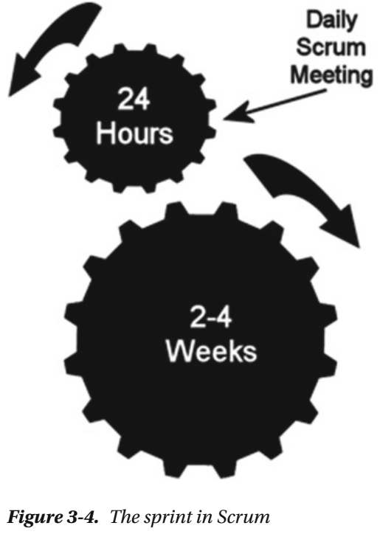
Figure 3-4

Slide 146
Sprint Review
When a sprint comes to an end, the stakeholders perform a sprint review .
This meeting is also time boxed, but at four hours instead of eight.
The product owner and the stakeholders get a chance to see what the team has produced during the sprint and reflect on it.
But it’s important to remember that this meeting isn’t a demonstration: it’s a collaborative meeting of the people involved.

Slide 147
Sprint Retrospective
Now there is only one meeting left: the sprint retrospective.
It takes place between the sprint review and the next sprint planning meeting.
It’s time-boxed at three hours.
The Scrum master encourages the team to adjust the development process, still within the Scrum process and practices framework boundaries, so that the process can be more effective for the next sprint.

Slide 148
Documentation
Some think that documentation and planning aren’t necessary in Scrum.
Developers like this idea because they don’t want to write documents, whereas stakeholders tremble at the thought.
But nothing could be further from the truth.
Scrum doesn’t say you don’t document or a plan. The contrary is true.
Planning, for instance, is done every day, during the daily Scrum (see Figure 3-5 ).
Documents should also be written, but you scale away documents that aren’t necessary—those that are produced only for the sake of documentation and are almost never read after they’re produced.
You document what is needed for the system and the project.
You document your code, you document traceability, and so on.

Slide 149
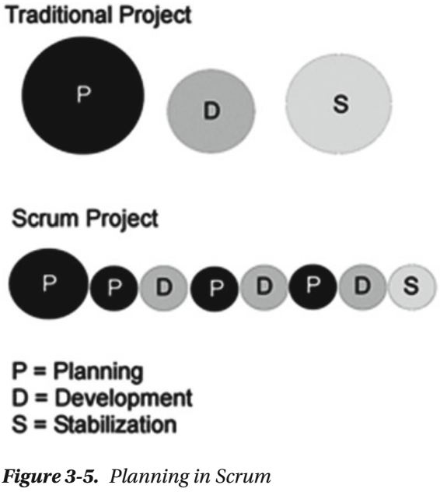
Figure 3-5

Slide 150
Summary
That’s basically it. Scrum is a lean process and appeals a great deal to us.
Joachim had the privilege of doing his Scrum master certification during a course held by Ken Schwaber and his product owner certification training at a course held by Mike Cohn; these are two of the legends in the agile world.
Unfortunately, some customers and stakeholders find Scrum a bit vague, so they won’t try it.
They think they have more control with the way they used to run projects and are perhaps afraid to embrace this modern way of doing projects.
This hasn’t changed over the years, although more and more people we meet have seen what Scrum and agile can do to help them run better projects.
We’ve found that some companies think they’re using Scrum just because they develop iteratively.
In many cases, they have changed the Scrum process so that it won’t help them solve their development problems—problems that are clearly visible in a true Scrum project.
Instead, they use Scrum like makeup to cover the bad spots; and when the project still fails, they argue that Scrum doesn’t work—
they still don’t deliver value
they still have overruns, and so on

Slide 151
Summary |
When you’re implementing Scrum, follow the process and framework, and adjust the organization to Scrum, not the Scrum process to the organization.
This can be a real problem in some organizations where, as we said, management resists change and won’t use Scrum or agile for the simple reason that they think they will lose control.
If you aren’t in a position to enforce a new way of working, you need to consider how to most efficiently push management in the agile direction.

Slide 152
Definition of Done
The Definition of Done (DoD) is very important, but it also tends to be forgotten.
In many projects, at the end of (or during) a sprint or the project, we’ve seen arguments between the delivering development organization and the person ordering the project about whether a task has been done.
Perhaps testing was not done the way the client assumed it would be, or the software doesn’t comply with certain regulations.
The following conversation is typical:
The product owner (PO), Sofia, stops by the office of developer Mike to check on how things are going.
S: “Hi. How’s the new cool feature you’re working on coming along?”
M: “It’s going great. I’m done with it right now and will start the next feature soon.”
S: “Great! Then I can show it to our customer, who’s coming here after lunch. He’ll be very excited!”
M: “No, no. Hold on. I am not ‘done’ done with it. I still need to fix some test cases, do some refactoring, get it into the build process, and so on. I thought you were wondering if I had gotten somewhere with it …”
For the most part, such arguments can be avoided if people sit down together at the beginning and write and sign a DoD.

Slide 153
Why DoD?
There are other reasons for having a DoD, as well.
In order for the team to estimate a user story, the members need to know when they’re done with it.
Otherwise, it’s very hard to complete the estimate.
For a specific user story, you know it’s done when you’ve fulfilled its acceptance criteria.
But where do all those general things like style guides, code analysis, build automation, test automation, regulatory compliance, governance, non-functional requirements, and so on, fit in?
They affect the estimate of a user story as well.
Here is where the DoD comes into play.
The DoD tells you what requirements in addition to the user story’s acceptance criteria you need to fulfill in order to be done with the story.
You include the general requirements in the DoD because they affect all user stories in the end.
The DoD is your primary quality document. If you don’t fulfill what is in it, you don’t deliver quality.
It’s essential that the PO and the team agree on the DoD.
The DoD is part of the agreement between the team and the PO.
There shouldn’t be an argument over this concept during the project.

Slide 154
Why DoD? |
If the PO thinks it’s too costly to use pair programming or test-driven development (TDD), have the PO sign the DoD, which specifies that these things have been removed.
If, at the end of a sprint, the PO complains about the number of bugs, you can present the document and say that the PO removed essential parts of the testing process, and hence bugs will be present.

Slide 155
DoD Starting Point
A good starting point for a DoD for an approved user story could be something like the following:
All code is written and checked in (including tests)
Coding conventions have been fulfilled (these are documented in a separate document and not included here)
All unit tests have been passed (must be okay before check-in)
Code is refactored (improved/optimized without change of function)
All code has been reviewed by at least two people (peer programming or peer review)
The user story is included in the build (build scripts updated, all new modules included)
The user story is installable (build scripts updated so the story is included in the automatic install)
All acceptance tests have been passed:
Acceptance criteria must exist
Acceptance tests are implemented (automatic or manual tests)
The backlog has been updated as follows:
All tasks’ remaining time is 0
The user story state is Done

Slide 156
DoD Starting Point |
Actual Hours has been updated
All tasks are Done
The user story has been installed on Demoserver
The user story has been reviewed by the PO
The user story has been approved by the PO
Product documentation has been updated and checked in
A user manual has been written
The administrative manual has been updated
Help texts have been written

Slide 157
DoD – when Sprint is Finished
You could also have a DoD like the following for when the sprint is finished:
All user stories in the sprint fulfill the DoD
The product has been versioned (release management/rollback)
All accepted bugs have been corrected
New bugs that have been identified are closed and/or parked
80% code coverage from automated tests is fulfilled
All chores are done and approved
All integration tests have been passed
The sprint retrospective has taken place, and actions for improvements have been identified
The sprint review has taken place with the PO present
A performance test of the complete system has been done
Let’s continue by looking at how you can manage requirements and estimations with an agile mindset.

Slide 158
Agile Requirements and Estimation
Agile requirements and estimation is a huge but important topic.
This section covers some of the most important topics here, but there are a lot of ways you can manage requirements and estimates.
If you want to master this subject, there are several training modules you can take and books to read.
A good starting point is to visit www.scrum.org or www.scrumalliance.com and see what they currently suggest.
Most of the agile planning and estimation tips and tricks in this chapter come from the agile community but aren’t specific to Scrum.
Scrum really doesn’t tell you how to do specific things like planning, estimation, and so on.
Scrum is the process framework or process method you use for running your agile projects.
However, Scrum works very well with the concepts we look at next.

Slide 159
Requirements
In agile projects, you usually represent requirements in something called user stories.
These can be looked at as fluffy requirements—a bit like use cases.
You write user stories like this:
One example could be
Figure 3-6 shows how Microsoft has implemented a user story into the work item type Product Backlog Item in Microsoft Team Foundation Server (TFS).
The terminology is a little different from the previous description, but it works.
User stories capture requirements at a high level and aren’t tangled up with detailed functions or implementation details.

Slide 160
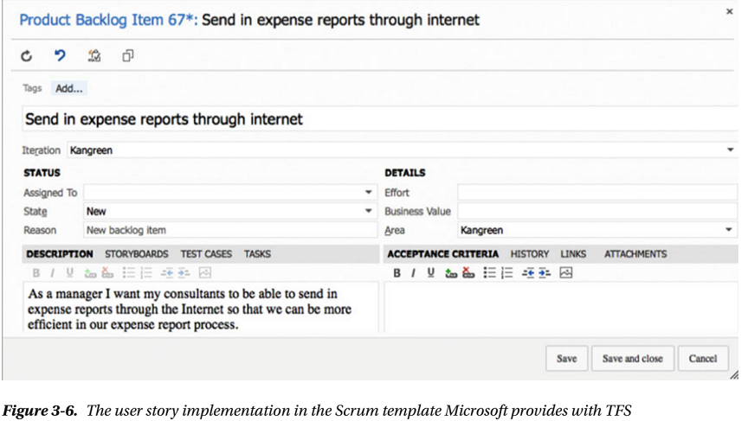
Figure 3-6

Slide 161
Acceptance Criteria
The details and non-functional requirements are instead captured as acceptance criteria for the user story.
Based on these acceptance criteria, you can develop acceptance tests at the same time you write the requirements.
The DoD is also important here because it describes other important requirements that all user stories need to fulfill before they’re done.
So, how can you begin gathering requirements before you start a project? POs should use any method they think is suitable.

Slide 162
Story-writing Workshop
We often use story-writing workshops where important stakeholders, end users, business analysts, experienced developers, and others participate to brainstorm the user stories they can think of.
During such a workshop, you focus on the big picture and don’t dive into details.
These big user stories are often called epics because they’re large and not broken down yet.
But don’t you need to find all requirements at the beginning? No.
And that is what makes agile so great.
The agile concept builds on the fact that you acknowledge that you don’t know and can’t know all the requirements early in the project.
New requirements and changes to early requirements will pop up throughout the process, and that’s okay.
The agile approach takes care of this for you.
You start with what you have initially, and you continue handling requirements throughout the project.
The short version is that you get started right a way and are aware that changes and new requirements will come along.

Slide 163
Risk Assessment
When the initial requirements are finished, you have the embryo of the product backlog.
However, before you can prioritize and estimate these user stories, you need to perform a risk assessment so you can get a grip on the risks associated with each and every one of them.
A user story with a significant risk associated with it usually takes more effort to finish and should probably be done early in development.

Slide 164
Estimation
To know how much effort is involved with a user story, you need to estimate it.
The sum of all initial estimates gives you a (very) rough estimate of how much time the entire project may take.
But because you know things usually change over time, you don’t consider this estimate written in stone.
You have what you need to do estimation:
you know the requirements
you have a DoD
you have acceptance criteria.
In the agile world, it’s recommended that you estimate time in something called story points.

Slide 165
Story Points
Story points aren’t an exact size—instead, they’re relative.
Here is an easy example we use when running agile training.
Take four animals—let’s say a cat, a pig, a zebra, and an elephant.
Without being a zoologist, most people can say that the pig is three times the size of the cat, the zebra is twice the size of a pig, and the elephant is maybe four times the size of the zebra.
If you have a couple of people sit down and discuss these animal sizes, you can pretty soon come up with an agreement about their relative sizes.
The same goes for user stories.
Most developers can agree pretty quickly about the relative size of user stories.
User story A is twice as big as user story B, and so on.
You don’t need to be very experienced with the details of each user story to reach this agreement.
Novice developers usually end up with the same estimates as experienced ones.
Keep in mind that you aren’t talking exact time yet, only relative size.
The most common scale for expressing story points is a modified Fibonacci scale.
This scale follows the sequence 1, 2, 3, 5, 8, 13, 20, 40, 100.

Slide 166
Planning Poker
Often, teams use a technique called planning poker when making estimates.
Each player has a deck of cards containing the numbers from the modified Fibonacci scale.
Here is how planning poker goes:
The PO/Scrum master (SM) reads the first user story.
The team members briefly consider the user story and select a card each, without showing it to the others.
The team members show their cards at the same time.
If the result varies much, the people with the highest and lowest cards explain their reasoning.
After a short discussion, the team plays again.
When consensus is reached (or the team members are only one step apart), you’re finished.
If the team still disagrees, you pick the highest value.

Slide 167
Estimating Time
But what about time? How do you get down to time? You need to know several things to estimate time.
The first is team capacity . Consider the following when calculating team capacity:
How long is the sprint?
How many working days are available in the sprint?
How many days does each team member work during the sprint? Consider planned vacation or other days off, planned meetings, and so on.
Deduct the time for sprint planning, review, and retrospective meetings.
The result is the capacity before drag ( drag is waste time or unknown activities).
You should measure drag in each sprint, but at the initial planning it’s hard to know how much to include.
The longer the project, the more accurate the drag.
If you don’t know from experience what the drag is, 25% is a good landmark; included in this is 10% backlog grooming.
Now you have the available number of hours in the sprint, and you can connect points and time. You need to know the team velocity.

Slide 168
Team Velocity
Team velocity is the number of story points the team can handle in a sprint.
Initially this is impossible to know.
The easiest way to figure it out is to perform a sprint planning meeting and create a theoretical team velocity.
At this meeting, the team breaks down a user story into manageable tasks—and this is where time becomes interesting.
During this meeting, the team estimates tasks in hours so they can plan the sprint and decide how many user stories they can take on.
The team usually does this as follows:
Estimate the first user story in detail.
Break down what the team needs to do to deliver the story.
Estimate hours for each activity and summarize.
Deduct the summary from the available time the team has in the sprint.
Is there still time left?
If so, take a new user story and repeat the process until no time is left.
Summarize the number of story points from the stories included in the sprint.

Slide 169
Team Velocity |
Now you have a theoretical velocity.
At this point you can make a rough time plan for the entire project (at this point).
This is good input for the POs in their discussions with stakeholders, and also for ROI calculations.
The sprint planning process continues throughout the project, and the theoretical velocity can soon be replaced with one based on experience.

Slide 170
Backlog
When the initial user stories are in place and estimated with story points, the PO can begin prioritizing the backlog.
In Scrum, this is called ordering the backlog .
Based on the business needs, the PO makes sure the order of the backlog reflects what the business wants.
In Figure 3-7 , you can see a backlog in Visual Studio Team Services.
Usually we do a rough estimate for each backlog item and then a velocity planning.
After that, we can see what backlog items should be completed during which sprint.
The PO needs to keep the backlog in good shape throughout the project.
This means it needs to be ordered.
It also needs fine granularity at the top (perhaps three or four sprints down the list) and rougher granularity further down.
Keeping the backlog in your ALM toolset gives you the benefit of visibility and traceability.
In the best of all worlds, you can link backlog items to code, check-ins, builds, and so on, giving you good traceability.

Slide 171
Backlog |
The PO can also start to look at release planning at this point.
It’s important to get an overview of coming releases, especially if you have a larger project.
Release planning can be done on the epics (the larger user stories).
A good approach is to look for themes among the user stories.
What could be useful to release at the same time?
If you find such features, you can make a theme from them and plan the theme for a certain release.
When this is done, you can also do a very rough time estimate on the releases—and suddenly you also have a rough time plan for the entire project.
Now you have as much information as you could possibly ask for this early in a project.
The next step is the sprint planning meeting, when the team members (as you saw earlier) select the backlog items they feel they can commit to during the sprint.

Slide 172
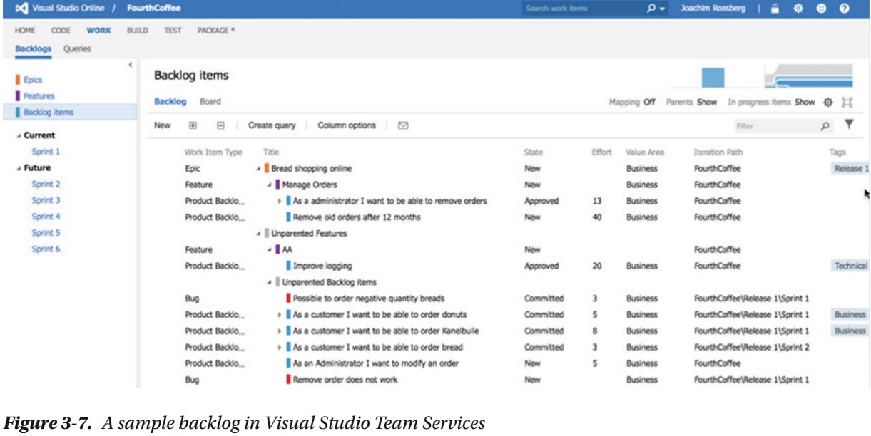
Figure 3-7

Slide 173
During the Sprint
During the sprint, you use several important meetings to inspect and adapt your process.
We already covered the sprint planning meeting, which takes place at the start of each sprint.
But there are other meetings as well, all important to the agile team.

Slide 174
Daily Stand-Up
The daily stand-up is a meeting that takes place every day during the sprint.
This is primarily a developer team meeting and is used to provide status updates to the team members.
As the name suggests, this is a stand-up meeting: this comes from the practice of having attendees stand at a meeting because the discomfort of standing for long periods helps keep the meeting short.
The daily stand-ups are kept short, at around 15 minutes, so participants should be reminded that it isn’t a working meeting.
As mentioned earlier, all participants should answer these three questions:
What did I do yesterday that helped the development team meet the sprint goal?
What will I do today to help the development team meet the sprint goal?
Do I see any impediment that prevents me or the development team from meeting the sprint goal?
Though it may not be practical to limit all discussion to these three questions, the goal is to stick as closely as possible to them.
If further discussions are needed, they should be scheduled for after the meeting.
For instance, when team members ask for short clarifications and brief statements, they should try to remember that they should talk about those more after the meeting.

Slide 175
Daily Stand-Up |
One of the important features of the daily stand-up is that it’s intended to be a communication meeting for team members and not a status update for management or other stakeholders.
However, it can be valuable for POs to participate in the meeting so they can catch any issues they need to get involved in.
This can remove the need for other status meetings afterward.
The meeting is usually held at the same time and place every working day.
All team members are encouraged to attend, but the meetings aren’t postponed if some team members aren’t present.
This practice also promotes closer working relationships with its frequency, need for follow-up conversations, and short duration, which in turn results in a higher rate of knowledge transfer—a much more active result than a typical status meeting.

Slide 176
Sprint Review
Once the sprint has come to an end, you hold another important meeting:
the sprint review
At this meeting, the development team shows the result of what they did during the sprint.
They show only the potentially shippable increments of software that they finished during the sprint.
Typically this is accomplished using a demo.
Most often the PO, the development team, management, customers, and developers from other projects participate in the sprint review.
During the meeting, the project is assessed against the sprint goal determined during the sprint planning meeting.
Ideally the team has completed each product backlog item brought into the sprint, but it’s more important that the team achieves the overall goal of the sprint.
If some PBIs aren’t finished during the sprint, they’re put back on the project backlog, and the PO needs to prioritize them for the coming sprint.

Slide 177
Sprint Retrospective
The most important meeting takes place after the sprint review.
This meeting is often the last thing that happens in a sprint and is called the sprint retrospective.
It’s an opportunity for the team to learn from mistakes by inspecting the sprint and adapting to the results of the inspection.
No matter how good a Scrum team is, there are always opportunities to improve.
A good Scrum team constantly looks for improvement opportunities, and the team should set aside a brief, dedicated period at the end of each sprint to deliberately reflect on how it’s doing and to find ways to improve. Hence the sprint retrospective.
Participants in this meeting should be the development team, the SM, and the PO.
Set aside about an hour for this meeting.
There are many ways to do a sprint retrospective.
One way is to let the team come up with what was good and what was bad during the sprint.
Note these items on a board, and then select (by voting) a number of topics (three to five) from the bad side.
Then create action plans for how to improve on them.

Slide 178
Sprint Retrospective |
Another way is a start-stop-continue meeting.
Using this approach, each team member is asked to identify specific things that the team should
Start doing
Stop doing
Continue doing
After an initial list of ideas has been brainstormed, team members proceed and create action plans for how to improve on the “stop doing” issues
At the end of the sprint, the next retrospective is often begun by reviewing the list of things selected for attention in the prior retrospective.
Now that you have seen how Scrum is supposed to work, I want to discuss some other agile methodologies that are very commonly used.
Scrum is a great process (or rather framework), but it is not the best choice for all organizations or projects.

Slide 179
Kanban

Slide 180
Extreme Programming

Slide 181
Scaling Scrum
What happens if you have more team members than can fit on a Scrum team (seven plus/minus two people)?
What if 90 people are involved in the project? Can Scrum scale to handle this?
According to Mike Cohn, in an article on the Scrum Alliance web site, you can use a process called Scrum of Scrums : The Scrum of Scrums meeting is an important technique in scaling Scrum to large project teams.
These meetings allow clusters of teams to discuss their work, focusing especially on areas of overlap and integration.
Imagine a perfectly balanced project comprising seven teams each with seven team members.
Each of the seven teams would conduct (simultaneously or sequentially) its own daily Scrum meeting.
Each team would then designate one person to also attend a Scrum of Scrums meeting.
The decision of who to send should belong to the team.
Usually the person chosen should be a technical contributor on the team -
a programmer Tester
database administrator designer, and so on
rather than a product owner or Scrum master.

Slide 182
Scaling Scrum |
By using this technique, you can scale Scrum infinitely, at least in theory.
But there are other ways to scale Scrum and agile as well.
We will take a look at two of them here:
Scaled Agile Framework (SAFe)
Scaled Professional Scrum (SPS)

Slide 183
SAFe

Slide 184
Scaled Professional Scrum (SPS)

Slide 185
How Agile Maps to ALM
According to Forrester, agile adoption has brought about significant support for ALM practices.
The agile way of working using frequent inspection and adaption coupled with increased delivery cadence has made teams more disciplined in their way of working.
When agile was introduced, many people thought the opposite would be true; but reality has proved them wrong.
What parts of agile map to the ALM process? Let’s look at what Forrester says.

Slide 186
Agile Captures Task-Based Work
Daily stand-up meetings allow team members to report progress against their tasks.
As you’ve seen in this chapter, the PBIs are broken down into tasks during sprint planning, and each task is reported on, aggregating the results to the original PBI.
Using digital tooling for this—such as Mylyn from Tasktop and TFS from Microsoft—allows you to capture effort, time, and other metadata, which can provide valuable insight into the real progress of your software development.

Slide 187
Increased Frequency of Inspection
The iterative approach to development improves the frequency of inspection.
During each sprint, you have project inspection at each daily stand-up.
At the end of a sprint, during the sprint retrospective, you define what you’ve done well and what needs to be improved.
This improves the feedback loop and, together with better visibility for reporting and traceability, has far-reaching implications for ALM.

Slide 188
Many Tools Collect Much Information
Many agile teams use tools that help them collect build and integration information in their continuous integration flow.
This improves visibility into the build process as well as traceability, because the tools often allow the team to see which requirements, work items, and tests each build included.

Slide 189
NOTE
“Continuous Integration is a software development practice where members of a team integrate their work frequently, usually each person integrates at least daily, leading to multiple integrations per day.
Each integration is verified by an automated build (including test) to detect integration errors as quickly as possible.
Many teams find that this approach leads to significantly reduced integration problems and allows a team to develop cohesive software more rapidly.” —Martin Fowler

Slide 190
Test Artifacts Are Important
Agile teams often use test-driven development and increase the importance of test artifacts.
Business analysts and quality assurance practices are converging, which is something that agile methods encourage.
Agile’s emphasis on the definition of done and frequent inspection increases the desire to link work items with test plans and cases.
The result is that agile teams create simpler requirements but see higher integration with test assets.

Slide 191
Agile Teams Plan Frequently
Agile teams plan more frequently than traditional teams.
Planning takes place
when creating work items
during sprint planning
during daily stand-ups
during backlog grooming and so on
As a result, agile teams have more information about their projects, such as estimates, actual results, and predictions.
This enables ALM to move center stage, because planning activities are an important management component of an ALM application.

Slide 192
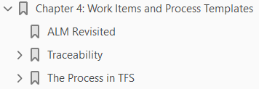
4
Work Items and Process Templates

Slide 193
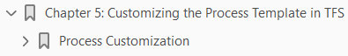
5
Customizing the Process Template in TFS

Slide 194
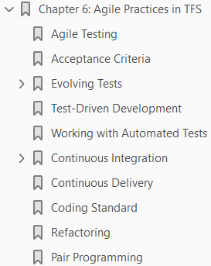
6
Agile Practices in TFS

Slide 195
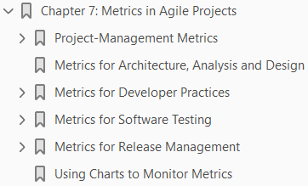
7
Metrics in Agile Projects

Slide 196
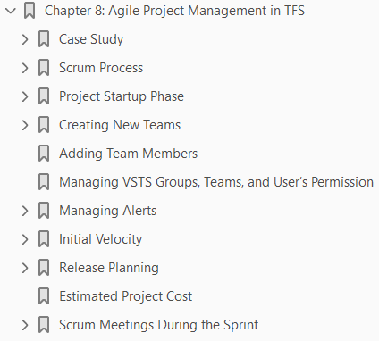
8
Agile Project Management in TFS

